Slide 1
Going for Gold: Avail Scholarship Opportunities Around the world
Prof Dr. BS Chowdhry
Dean FEECE
MUET
PEC JOB FAIR
25th Oct 2014

Slide 2
Going for Gold
British television game show that originally aired on BBC1 between 12 October 1987 and 9 July 1996.
It was presented by Irish broadcaster Henry Kelly
A famous lunch time Quiz program competition between 28 European countries nationals.
Going for Gold had a memorable theme tune which was composed by Hans Zimmer, a German composer who has since carved a successful career in Hollywood .
Hans Zimmer : Going For Gold truly meant that I wasn't starving, and I could pay my rent and I could pay the electricity bill.

Slide 3
Flow of presentation
To inspire, motivate, and empower young budding engineers to take charge of their lives and be all what they should be.
To show the tricks of the trade for:
Building your career,
Availing scholarship opportunities,
Setting your targets: Sky your limit

Slide 4
What are we in for?
A recent survey from Parent point of view:
They Hate to the ICT revolution.
The world has become dungeon.
No innovation from ones own mind.
Students do not learn how to set their goals and objectives
There are no job opportunities for Engineers

Slide 5
My point of View
Thanks to the ICT revolution.
The world has become truly a global village.
Everything is a click way.
PEC has been working day & night for your recognition:
CPD
Washington Accord
It is essential to set your target and goals in this edge of competition where survival is for the fittest.
One has to look for the opportunities with full determination.

Slide 6
SUCCESS IS YOUR BIRTHRIGHT
Time is most precious treasure
1Y-FAILS IN EXAM
1 M-PM BABY
1 D- LABOUR
1 H- G.F , B.F
1 M- TRAIN / Plane
1 S- Accident
1mS- OLYMPICS

Slide 7
YOU ARE
BORN TO INNOVATE

Slide 8
My Algorithm for Road to Success
Forget injuries, never forget kindness
Positive attitude
Burning desire
Own everything
Appreciate yourself
Give back to Society
Change in Attitude

Slide 9
Knowledge is Power: A Free Recipe for growth & Success
Have a DIAMOND Diary:
10 new English words Daily in the note book
TV / Computer Book/Newspaper Book
Leading Scientist / Inventor name : 1 or 2 daily
Richest person in the world: Review 1 profile daily
Professional bodies in the world
International Awards (e.g JCI Senatorship)
Job Opportunities in International Organizations
Review your own core subjects (Def, Abbreviations etc)

Slide 10
In 1999, Zewail became the 1st Egyptian national to receive the Nobel Prize in Chemistry

Slide 11
Femtochemistry is the area of physical chemistry that studies chemical reactions on extremely short timescales, approximately 10⁻¹⁵ seconds

Slide 12
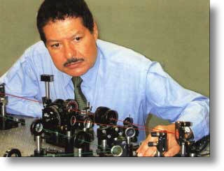

Slide 13
Dema and Dr.Ahmed Zewail Meet King Gustav and Queen Silvia of Sweden

Slide 14
With Bill Clinton

Slide 15
MAKING IT HAPPEN
Anyone who has never made a mistake has never tried anything new. (Albert Einstein)
“The word impossible is not in my dictionary.” Napoleon Bonaparte quotes (French General, Politician and Emperor (1804-14).

Slide 16
Success is Hidden in Failure!
Failures are to teach not to block our growth.
They provide us learning opportunities.
As some says we cannot change wind, but can always adjust our sails.
For me and thousands others, failures are blessings.

Slide 17
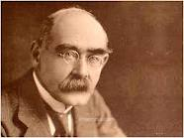
Who did not FAIL!
During its first year of business, the Coca-Cola Company sold only 400 cokes.
Basketball superstar Michael Jordan was rejected by his high school basketball team, because coach believed that he was no good.
Famous Poet, story writer Joseph Kipling once
received a rejection letter from an examiner saying
he did not know the use of English Language.
Winston Churchill was not accepted at the Oxford and Cambridge universities.
Albert Einstein’s doctoral dissertation was rejected by the university of Bern saying they it was irrelevant and fanciful.
When Alexander Graham Bell invented the telephone, he made a demonstration to the president who told him that it was good, but no one would use it.

Slide 18
Who did not FAIL!
Henry Ford failed and went broke five times before he succeeded with his FORD MOTOR COMPANY.
Thomas Edison was rated in his school as being “too slow”. As a result Edison mother taught him ay home.
When Thomas Edison invented the light bulb, he failed 6000 times before he finally succeeded.
Franklin D. Roosevelt was paralyzed by polio at the age of 39, and yet he became the president of the USA, four times.
Walt Disney was fired by a newspaper editor of lack of ideas.
He also went bankrupt several times before he built Disneyland.

Slide 19
Who Did not Fail!
Soichiro Honda was rejected for a job as an engineer at Toyota motors and started his company building scooters at his home
JK Rowling was fired from her job as a secretary in Amnesty International for day dreaming, she went on to publish the famous Harry Potter Series
Bill Gate’s teacher at Harvard Uni. told him that he has no talent at all.
Several years later USA Presidents said we are Bill Gates nation.

Slide 20
Dhirubhai Ambani worked as a clerk in Yamen when he was 16. He is the founder of Reliance industries.
He went to see Engineering Consultant office to collect his company certificate and……. saw poster at CEO office ….."Believe you can, and you are half way there" (Theodore Roosevelt)……Changed his life…. More than 20 Billion Dollar company
Reliance Power ( More than 20,000 MW), Reliance Communications, Reliance Infrastructure, Reliance Capital, Reliance Entertainment, Reliance Health, Reliance Natural Resources, Reliance Venture, Reliance MediaWorks Ltd

Slide 21
A PROFILE OF WINNER’s
1816 His family was thrown out from their home. He had to work to support them. (b 12 Feb 1809)
1818 His mother died (Age 09 Years)
1831 Failed in business. (Age 22 Years)
1832 Ran for state legislature but lost it. Also lost his job wanted to go to a law school but couldn’t get in.
1834 Ran for state legislature the second time and won.

Slide 22
Cont…..A PROFILE OF WINNER
1835 Was engaged, few days later his sweetheart died. His heart was broken and he had a nervous breakdown.
1843 Ran for congress but lost.
1846 Ran for congress again and won. Moved to Washington and did a good job.
1848 Ran re-election to congress and lost it again.
1854 Ran for senate of the United State and lost.
1856 Lost vice Presidential election of his party.
1858 Ran for U.S senate again and lost again.
1860 Elected president of the USA

Slide 23
Yes, he was ABRAHIM LINCLON

Slide 24
Steve Jobs who lost his JOB
Steve Jobs struggled at school and dropped out of college after just one semester
In 1972, before Steve Jobs and Steve Wozniak co-founded Apple, they worked in a San Jose mall dressing up characters from Alice in Wonderland
In 1976, Steve Jobs and Steve Wozniak co-founded Apple Computers
Subsequently in the same year Apple 1 was created and they started making them in Jobs garage

Slide 25
Steve Jobs who lost his JOB
In 1984, Steve Jobs unveiled the Macintosh which was the first mass marketed personal computer having a GUI and a mouse
In 1985, Steve Jobs was fired from the company he helped found by a person he asked to come work in Apple
Determined to be successful he founded NeXT Inc later that year and released the NeXT Computer in 1988

Slide 26
Steve Jobs - Back in JOB
The NeXT computer boasted a digital signal processor chip, a built-in Ethernet port. Tim Berners-Lee invented the World Wide Web on a NeXT computer at CERN.
During this time he bought formed Pixar, the animation company responsible for the Toy Story series, The Incredibles, Finding Nemo and Ratatouille
In 1997, Jobs returned back to Apple during troubling times
He came back with the think different mantra
and saw the development of the ipod, Mac and he
Iphone

Slide 27
Do you know how much salary did Steve Jobs take?

Slide 28
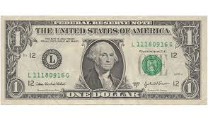
One Dollar per year

Slide 29
A Celebration of Success.
Although Steve Jobs's salary was just $1, he owned 5.5 million Apple shares, so when the shares rose, he became a lot richer.
Bill Gates goes to bed and wakes up….290Million Dollar…Richer then he went to bed (23rd Oct, 14)
Several current CEOs follow the $1 salary policy, including Mark Zuckerberg of Facebook and Larry Ellison at Oracle

Slide 31
Failing in anything is showing Road to Success

Slide 33
The 4 W’s

Slide 34
Career Choices
Interest
Planning
Goals
Skills
Salary
Preparation
Education

Slide 35
Planning: Diamond Diary
Steps:
What are your interest?
What do you want to be?
What are your skills?
What types of careers fit your skills and interest?
How do you prepare for the career?

Slide 36
Interest
What are your interests?
What do you like to do?
Think about experiences you have enjoyed.
Reassess yourself
What kind of social, professional activities do you like? JCI, IEEE, ACM, SPE, …….

Slide 37
Career Goal
What is your Career Goal?
A career goal helps you focus on what you want to do for a living.
A career goal can be a specific job you want to do -- such as
Teaching,
Research,
working in Industry, Banks, Public sector, social service

Slide 38
Skills
To be successful in the field of engineering, one must have certain qualities. Some of those top qualities include:
1. Possesses a Strong Analytical Aptitude
2. Shows an Attention to Detail
3. Has Excellent Communication Skills
4. Takes Part in Continuing Education
5. Is Creative
6. Shows an Ability to Think Logically
7. Is Mathematically Inclined
8. Has Good Problem Solving Skills
9. Is a Team Player
10. Has Excellent Technical Knowledge

Slide 39
Preparation
How do you prepare for the career?
You can take standardized tests to help prepare for jobs.
Certifications from different
organizations like Siemens, CISCO, National Instruments etc

Slide 40
Education
What further education is required for your chosen career?
Erasmus Mundus Scholarships
US Fulbright
Australian Aid
UNU
Commonwealth
DAAD German Scholarships
Education Requirements

Slide 41
Scholarships and Financial Aid http://scholarship-positions.com/

Slide 42
Scholarships for Developing Countries
Islamic Development Bank Prize for Women’s Contribution to Development, 2014
Community Solutions Fellowship for Developing Countries in USA , 2015/16
TWAS Fellowships for Research and Advanced Training, 2015
International Climate Protection Fellowships for Developing Countries in Germany, 2015
Chevening/Cardiff Partnership Award for Masters Students in UK, 2015
Lex:lead Law Scholarship for Developing Countries’s Students, 2015
Chevening/Bangor Partnership Award for Masters Students in UK, 2015
Read more: Scholarships & Financial Aid 2014 2015 for Undergraduate, Masters, PhD Postdoctoral Students Scholarship Positions 2014 2015:
http://scholarship-positions.com

Slide 43
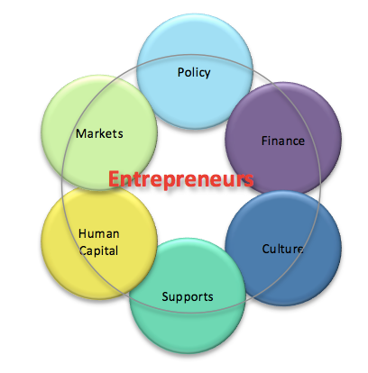
Career Choices
Shrinking of Public Sector job like Nanotechnology
Job options vary widely and in a developing economy like ours, there is an enormous potential for
entrepreneurship.
VC?
The Indus

Slide 44
The Indus Enterpreneurs (TIE)
Many thanks for contributing to the success of TiE Karachi’s event with Shahid Afridi Foundation (SAF) and helping raise a reasonable amount for a good cause. Without you, it would not have been possible.
We thank you for your faith, decent investment and active participation. Together, we made it a roaring success.

Slide 45
Salary
Salary requirements will also decide which line of work you go in to
Different careers offer
different perks
Job adverts
http://www.comm2excel.com/
Salary Information

Slide 46
Failure is the tuition you pay for your success (Walter Brunell)

Slide 47
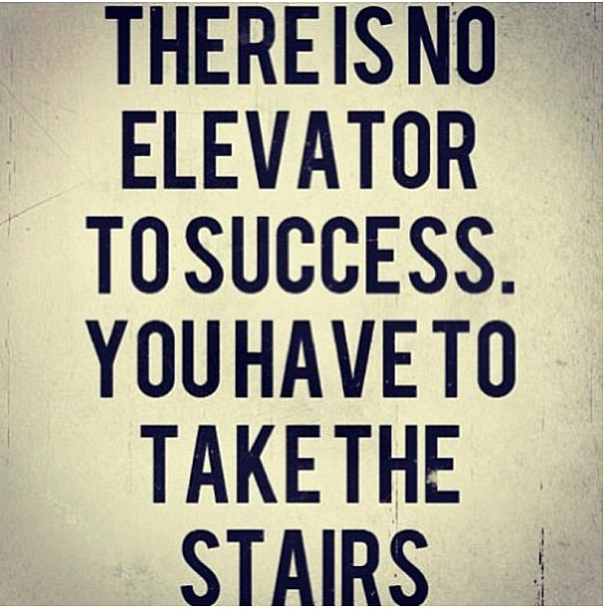

Slide 50
Career Road Map Guide for Engineers
Engr. Junaid Shaikh (Author)
& Dr. B. S. Chowdhry (Editor)
ISBN 978-969-9526-00-8
Available at: STANDARD BOOKS:
Office No. 31, Decent Garden,
Block – 7, Gulistan-e-Jouhar, Main University Road, Karachi.
Tel# 021-34016614, 35459807, Fax: 021-34016616, Email: standardbooks@hotmail.com
Price: Rs. 300

