Slide 1
Accreditation Workshop - Part 2
28 February 2014
Islamabad
Er. Professor Dr. Kai Sang LOCK
Washington Accord Mentor to PEC
A seminar organized by
Pakistan Engineering Council

Slide 2
Part 2
Implementing Outcomes-based Assessment & Preparing for Program Accreditation

Slide 3
Understanding Outcome-Based Assessment (OBA)

Slide 4
Traditional Approach for Quality Assurance of Engineering Programmes
Focused on the input & process quality
The criteria for accreditation may typically include the following list:
Organization and governance
Financial resources
Physical resources and facilities
Faculty and staff
Student intake quality
Teaching – learning process
Co-curricular and extra-curricular activities
Student services & counseling
Research & Development
Industrial interaction

Slide 5
Key features of OBA
OBA focuses more on:
Learning, as against teaching
Students
Outcomes, not inputs or capacity
OBA incorporates continuous improvement
to systematically analyze its systems for variance
make decisions based on facts
consciously define the organization’s customers – both internal and external
actively seek input from customers

Slide 6
Outcomes-based system
The emphasis is on measured “outcomes” rather than "inputs”
Outcomes include a range of skills and knowledge
Outcomes are measurable, observable
Outcomes (skills and knowledge) are specified, but not inputs
Identifying appropriate and measurable outcomes is difficult, and often controversial

Slide 7
Outcomes
Stipulate knowledge, skills, attitudes & behaviors on completion of program
Well documented
Defined by measurable performance indicators
Both direct & indirect assessment tools to measure each outcome

Slide 8
Writing Intended Learning Outcomes
Intended learning outcomes need to be written at both programme and course levels.
Both of them need two essential elements:
A statement of what content are the students expected to be able to do at the end of learning experience;
The levels of understanding or performance in those content areas.

Slide 9
Definition of terms used
Programme Educational Objectives
Programme educational objectives are broad statements that describe the career and professional accomplishments that the programme is preparing graduates to achieve (within 3 to 5 years after graduation)
Student Learning Outcomes
Student learning outcomes are narrower statements that describe what students are expected to know and be able to do by the time of graduation. These relate to the skills, knowledge, and behaviours that students acquire in their matriculation through the programme

Slide 10
Definition of terms used
Assessment
Assessment is one or more processes that identify, collect, and prepare data to evaluate the achievement of programme educational objectives and student learning outcomes
Evaluation
Evaluation is one or more processes for interpreting the data and evidence accumulated through assessment practices. Evaluation determines the extent to which programme educational objectives or student learning outcomes are being achieved, and results in decisions and actions to improve the programme

Slide 11
Accreditation Criteria of relevance to Outcome-Based Assessment (OBA)

Slide 12
Accreditation Criteria
11 criteria in EAB Accreditation Manual:
Mission & Programme Educational Objectives
Student Learning Outcomes
Curriculum and Teaching/Learning Processes
Students
Faculty members
Facilities & learning environment
Institutional support & financial resources
Governance
Interaction between institution & industry
Research & development
Specific Programme criteria

Slide 13
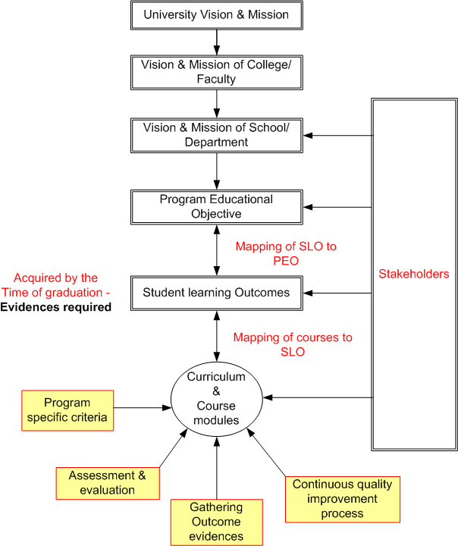

Slide 14
Mission
University mission?
Faculty (school) mission & departmental mission statement?
Alignment with mission of institution?
Published and known to stake-holders?

Slide 15
Programme Education Objectives (PEO)
Broad statements that describe what graduates are expected to attain within a few years after graduation
Align with university’s & engineering school’s mission
Well defined & documented & publicized
Stakeholders’ participation, including faculty
Manageable number of objectives
Define outcomes
Measurable
Feedback mechanism for improvement

Slide 16
Programme Educational Objective (PEO)
PEO consistent with mission?
Alignment with mission of institution?
Published and known to stake-holders?
Based on needs of constituencies?
Curriculum and processes that lead to attainment of PEO?
Common mistakes in setting PEO
Too broad and not specific to program
Too narrow and similar to SLO
Not known to stake-holders

Slide 17
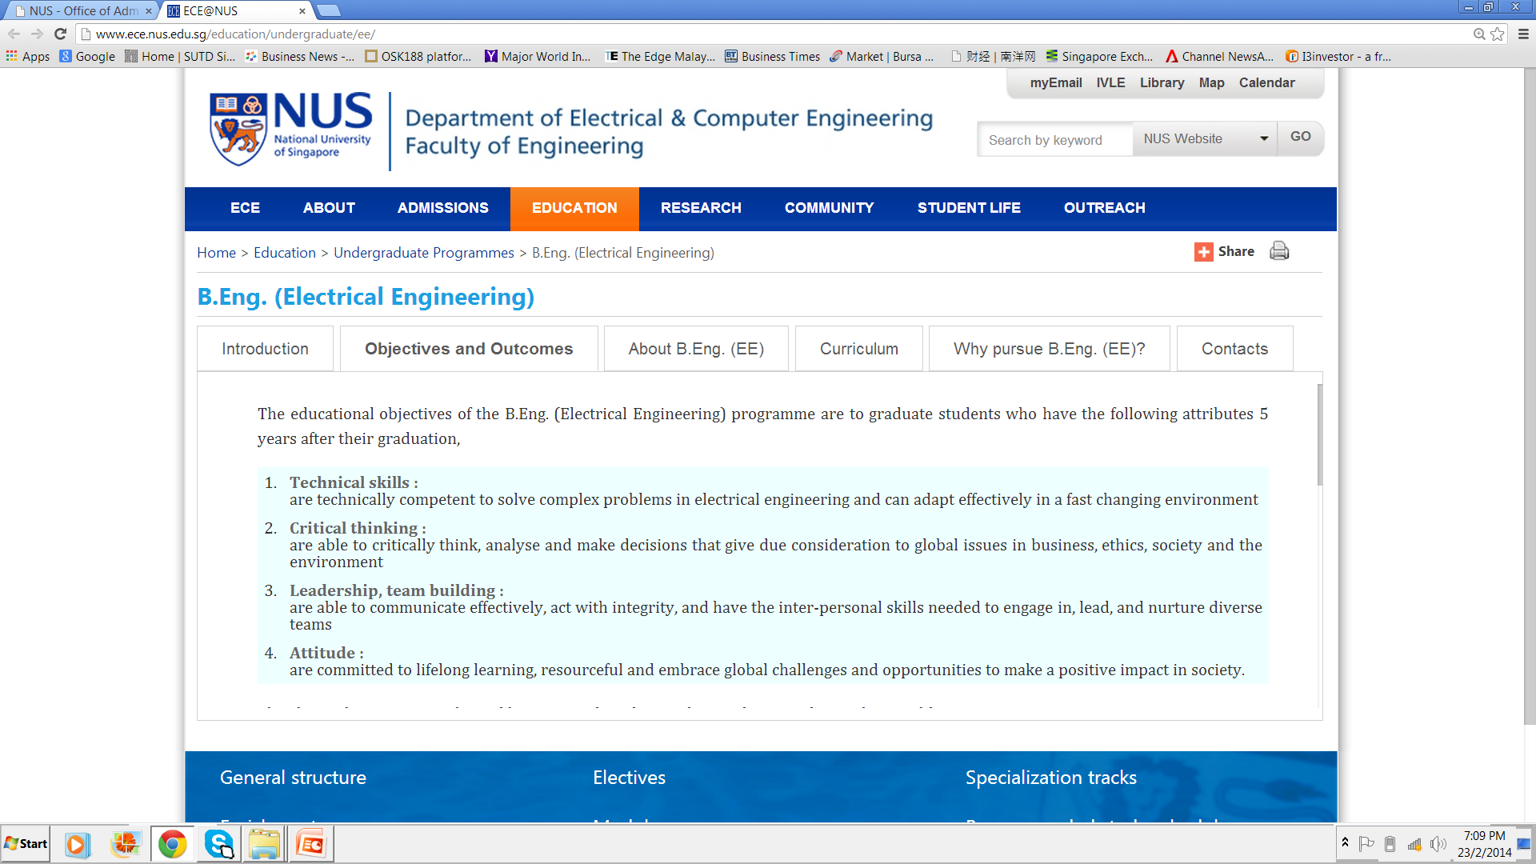

Slide 18
Achievement of PEO
Are assessment and evaluation processes in place to determine attainment of PEO?
Is there a continuous improvement mechanism in place?
Evidence and documentation is important.

Slide 19
Assessment of Programme Educational Objectives
What graduates are expected to attain within a few years after graduation
Ingredients to look out for:
Objectives are current and relevant
Methods and frequency to monitor if they are appropriate (usually every 2 to 3 yrs)
Constituents involved is appropriate
Student learning outcomes will enable its attainment
Effective assessment processes in place to evaluate achievement
Assessment method depends on factors like size of cohorts
Methods can include data from advisory boards, recruiters, employers, graduate surveys

Slide 20
Student Learning Outcomes
Student learning outcomes describe what students are expected to know and able to do by the time of graduation
These relate to knowledge, skills, and behaviors that student acquire as they progress through the program
Student learning outcomes to be stated and documented - in the form of graduate attributes
Provide mapping of program SLO with EAB’s SLO, if different
Relationship of SLO to PEO

Slide 25
Table 2.1 : Mapping of Student Learning Outcomes to graduate attributes
in EAB’s Criterion 2(i) (a) to (j)
Educational institution’s Student Learning Outcomes [if different from graduate attributes in Criterion 2(i) (a) to (j)] |  | Graduate attributes in EAB’s 2(i) (a) to (j)*
(1) | Student learning outcome (..)
(2) | Student learning outcome (…)
(3) | |
(4) | |

Slide 26
Assessment of Student Learning Outcomes
Collect data to assess the level students have attained outcomes
Evaluate results to assist in deciding how to improve teaching-learning processes
Key features to take note:
Assess performance of cohorts, not individual students
For each outcomes, identify key performance indicators@ (concrete actions students is able to perform)
Not necessary to collect data for every student in every course – data collection needs to be representative
Not necessary to have more than one data point to determine performance of an outcome
Not necessary to assess every outcome every year
Focus is on how data is used to understand strengths/weaknesses and continuous improvement
@ Definition by ABET: Specific, measurable statements identifying the performance(s) required to meet the outcome; confirmable through evidence

Slide 27
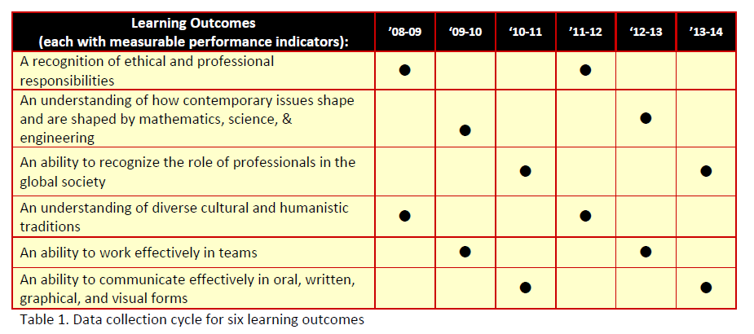
Reference (from ABET)
In program assessment planning, it is important to let common sense prevail. Example of how not having to assess every outcome every year:

Slide 28
Course Learning outcomes
Course Learning Outcomes describe what a student should be capable of as a result of learning experiences within a course
To be determined by the course instructor (s)
Mapping course learning outcomes to SLO to show learning experience meets the accreditation criteria
Each course may contribute to a list of SLOs, may contribute strongly to one or some SLOs and less strongly to other SLOs
When a course may contribute to several SLOs, usually only a subset of its strong outcomes need to be used for EAB assessment

Slide 29
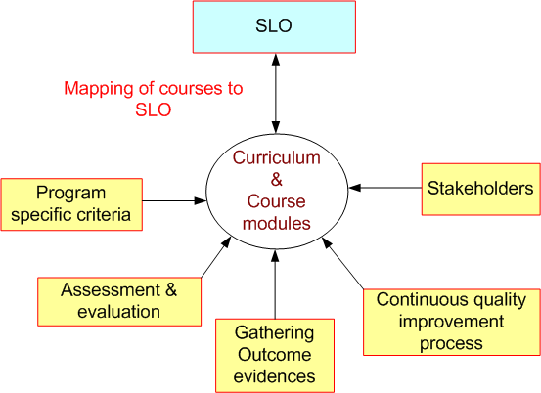

Slide 30
Defining Curriculum Objective and Intended Course Learning Outcomes
A learning outcome is what a student can do as a result of a learning experience.
It describes a specific task that student is able to perform at a given level of competence under a certain situation.
The three broad types of learning outcomes are:
Disciplinary knowledge and skills
Generic skills
Attitudes and values

Slide 31
Table 3.1: Curriculum and teaching processes to achieve Student Learning Outcomes,
and evaluation method/criteria
Module | Category# | Evaluation method & criteria | Student Learning Outcomes*
 |  |  | (1) | (2) | (3) | (4) | (5) | (6) | (7) | --

Slide 32
Course Learning outcomes
Course Learning Outcomes describe the complex performances a student should be capable of as a result of learning experiences within a course.
These are determined by the course instructor (s)
Mapping course learning outcomes to program outcomes and how overall learning experience meet the accreditation criteria

Slide 33
Contribution of each course
Each undergraduate course in the department contributes to a list of SLOs.
Usually, a course may contribute strongly to some EAB* SL outcomes and less strongly to other outcomes.
While a course may contribute to several NBA SLOs, usually only a subset of its strong outcomes need to be used for EAB* assessment.
*Adapted from: UCLA Electrical Engineering Department’s “Guide for instructors and teaching
Assistants of undergraduate courses

Slide 34
Teaching-Learning Processes
Each program should cover general and specialized professional content
Adequate breadth and depth, and
Appropriate components in Science and Humanities
Evaluation of teaching-learning processes
Modes of teaching-learning: lecture, tutorial, seminar, projects, internship, peer-group discussion, ..

Slide 35
Curriculum
Does the curriculum satisfy the program specific criteria of the particular engineering discipline?
Are performance indicators established to measure the outcomes of the courses with respect to the program outcomes of NBA criteria)?
Major design experience?
Prerequisites
Course syllabi
Cores and electives

Slide 36
Interaction between institution & industry
Involvement of industry stake-holders to ensure relevance of curriculum
Opportunity for students to acquire industrial experience via internships and design projects by professional engineers and faculty members with industrial experience
Communication channel with industry, e.g. industry advisory board

Slide 37
Assessment & Demonstration of Achievement
Breadth
Depth
Where gained
Learning Process
Assessment Methods

Slide 38
Abilities
Knowledge (gathering & recall)
Comprehending information
Application (making use of knowledge)
Analysis (taking apart)
Synthesis (putting together)
Evaluation (judging the outcome)
Creation

Slide 39
Activities | Action Verbs that provides evidence
Knowing | define, describe, identify, label, name, outline, reproduce, recall, select, state, present, be aware of, extract, organise, recount, write, recognise, measure, underline, repeat, relate, know, match.
Comprehension | interpret, translate, estimate, justify, comprehend, convert, clarity, defend, distinguish, estimate, explain, extend, generalise, exemplify, give examples of, infer, paraphrase, predict, rewrite, summarise, discuss, perform, report, present, restate, identify, illustrate, indicate, find, select, understand, represent, name, formulate, judge, contrast, translate, classify, express, compare.
Application of knowledge (understanding) | apply, solve, construct, demonstrate, change, compute, discover, manipulate, modify, operate, predict, prepare, produce, relate, show, use, give examples, exemplify, draw (up), select, explain how, find, choose, assess, practice, operate, illustrate, verify.
Analysis | recognise, distinguish between, evaluate, analyse, break down, differentiate, identify, illustrate how, infer, outline, point out, relate, select, separate, divide/subdivide, compare, contrast, justify, resolve, devote, examine, conclude, criticise, question, diagnose, identify, categorise, point out, elucidate.
Synthesis | propose, present, structure, integrate, formulate, teach, develop, combine, compile, compose, create, devise, design, explain, generate, modify, organise, plan, rearrange, reconstruct, relate, reorganise, revise, write, summarise, tell, account for, restate, report, alter, argue, order, select, manage, generalise, precise, derive, conclude, build up, engender, synthesise, put together, suggest, enlarge.
Evaluation | Judge, appraise, assess, conclude, compare, contrast, describe how, criticise, discriminate, justify, defend, evaluate, rate, determine, criticise, choose, value, question.

Slide 40
Bloom’s Taxonomy – Cognitive Domain
(modified by Anderson & Krathwohl)
Creation
Evaluation
Compare, decide …
Synthesis
Design …
Analysis
Analyse …
Application
Calculate …
Comprehension
Explain …
Knowledge (Remembering)
List …

Slide 41
Ability/ competency | Level | Definition
Knowledge | 1 | the remembering of previously learned material; it may involve the recall of a wide range of material from specific facts to complete theories, but all that is required is the bringing to mind of the appropriate information.
Comprehension | 2 | the ability to grasp the meaning of material; may be shown by translating material from one form to another (words to numbers), by interpreting material (explaining or summarizing), and by estimating future trends (predicting consequences or effects); this goes one step beyond the simple remembering of material, and represent the lowest level of understanding
Application | 3 | the ability to use learned material in new, concrete situations; may include the application of rules, methods, concepts, principles, laws, and theories; requires a higher level of understanding than those under comprehension.
Analysis | 4 | the ability to break down material into its component parts so that its organizational structure may be understood; may include the identification of parts, analysis of the relationship between parts, and recognition of the organizational principles involved; represents a higher level than comprehension and application because it requires an understanding of both the content and the structural form of the material.
Synthesis | 5 | the ability to put parts together to form a new whole; may involve the production of a unique communication, a plan of operations (research proposal), or a set of abstract relations (scheme for classifying information); stresses creative behaviors, with major emphasis on the formulation of new patterns or structure
Evaluation | 6 | the ability to judge the value of material for a given purpose, based on definite criteria; contains elements of all the other categories, plus conscious value judgments based on clearly defined criteria.
Creation | 7

Slide 42
Assessment of SLO
Assessment is big subject and probably the major challenge of the teaching faculty
Are assessment methods adequate to provide evidence of achievement of SLO?
Each learning outcome may be measured or evaluated in terms of performance indicators
Is there a system in place to ensure that each student will acquire the stated SLO before graduation? (bearing in mind the various core and optional subjects available, and overseas attachment)

Slide 43
Sustainable Program Assessment Processes
Direct and indirect methods of assessment to be applied to measure a wide variety of different student abilities
Consider best fit between program needs, satisfactory validity and affordability (time, money and effort)
Need to use multiple methods to maximise validity and reduce bias of any approach – triangulation.

Slide 44
Assessment
Assessment is one or more processes that identify, collect, and prepare data to evaluate the attainment of student learning outcomes and program educational objectives.
Effective assessment uses relevant direct, indirect, quantitative and qualitative measures as appropriate to the objective or outcome being measured.
Appropriate sampling method may be used as part of an assessment process.

Slide 45
Steps for assessment design
Define results to be measured
Identify data required and sources
Review existing assessment method
Define additional methods and measures
Implement & evaluate

Slide 46
Assessment Methods (Gloria Rogers)
Locally developed examinations
Oral exam
Written surveys and questionnaires
Commercial, norm-referenced, standardized exams
Exit and other interview
Focus groups
External examiner
Portfolios
Simulations
Performance appraisals
…

Slide 47
Examples of Assessment Methods in EC UK
Exams
Class tests
Project reports
Presentations
Lab reports
Design studies
Vivas/orals
Posters

Slide 48
Assessment tools and methods
Formative assessment The collection of information about student learning during the progression of a course or program in order to improve students learning. Example: reading the first lab reports of a class to assess whether some or all students in the group need a lesson on how to make them succinct and informative.

Slide 49
Assessment tools and methods
Summative assessment
The gathering of information at the conclusion of a course, program, or undergraduate career to improve learning or to meet accountability demands. When used for improvement, impacts the next cohort of students taking the course or program. Examples: examining student final exams in a course to see if certain specific areas of the curriculum were understood less well than others; analyzing senior projects for the ability to integrate across disciplines.

Slide 50
Rubric
A rubric is a set of criteria for assessing student work or performance. Rubrics are particularly suited to learning outcomes that are complex or not easily quantifiable, for which there are no clear “right” or “wrong” answers, or which are not evaluated with standardized tests or surveys. Assessment of writing, oral communication, critical thinking, or information literacy often requires rubrics.

Slide 51
Evaluation
Evaluation is one or more processes for interpreting the data and evidence accumulated through assessment processes.
Evaluation determines the extent to which student outcomes and program educational objectives are being attained.
Evaluation results in decisions and actions regarding program improvement.

Slide 52
Two Assessment Mechanisms
The End-of-Course Instructor Survey and
The Instructor Evaluation of Students’ Performance on an EAB*-related Problem
It is the main mechanism used to obtain instructor feedback on whether the students in the course achieved some of the desired course outcomes.
Adapted from: UCLA Electrical Engineering Department’s “Guide for instructors and teaching
Assistants of undergraduate courses

Slide 53
Student Survey
End-of-Course Student Surveys.
The Student Surveys collect student input on course material, course organization, and instruction.
Besides asking students questions about the quality of a course and its instruction, the surveys also assess, for each course, the main topics that students are expected to have been exposed to during the course.
Adapted from: UCLA Electrical Engineering Department’s “Guide for instructors and teaching
Assistants of undergraduate courses

Slide 54
Student Survey
Students are asked to rate, on a scale from Poor to Excellent, whether they feel they have had an opportunity to learn the Specific Course Outcomes well.
The student input is then summarized and tracked in:
1. Individual reports on Course Performance for each course offering.
2. Yearly reports on Course Performance during an academic year.
3. Quarterly reports on Department Performance.
4. Yearly reports on Department Performance.
Adapted from: UCLA Electrical Engineering Department’s “Guide for instructors and teaching
Assistants of undergraduate courses

Slide 55
Other student feedback mechanisms
Student feedback may be collected through two additional mechanisms:
Exit surveys administered to graduating seniors.
Student Advisory Committee.

Slide 56
Saving Samples of Student Works
Each course is required to save samples of student homework solutions, laboratory reports, project or design reports, and exam solutions, typically from poor to good quality.
At the end of each quarter, the lecturers of all undergraduate courses must compile a binder containing in addition to the solutions, the corresponding homework questions, exam questions, lab description, and project description.

Slide 57
Requirements of Continuous Quality Improvement

Slide 58
Figure 1 – Continuous Quality Improvement Process in Outcome-based Accreditation
Other feedback mechanisms
Institution Resources, Teaching & Learning Environment
Stake-holders
PEO
SLO
SLO Delivered
SLO
Curriculum & Course Modules
Other Curricular & Extra- Curricular Activities
SLO
Graduates
Working
In
industry
Course Module 2
Individual Course
Learning
Outcomes
1
Course Assessment & Evaluation by Course Lecturer
Institution Vision & Mission
SLO
Course Module 1
1
Course Assessment & Evaluation by Course Lecturer
2
SLO Assessment & Evaluation by
Management/Accreditation Committee
3
PEO Assessment & Evaluation
(Surveys, Interviews, etc) by
Management/Accreditation Committee
Continuous Quality Improvement

Slide 59
Continuous Quality Improvement Process within Outcomes-based Accreditation
Loop (1) - involvement of the course teacher in the continuous quality improvement process – fast response
Loop (2) - achievement of SLO at the programme level is evaluated at the exit point
Loop (3) - achievement of the programme education objectives from inputs and feedbacks from the stakeholders, e.g. industry employers and alumni

Slide 60
Challenges in OBA Implementation
Challenges to the education providers include:
Understanding clearly the requirements, procedure and policy of OBA
Setting appropriate PEO and SLO which are relevant, measurable and meeting OBA requirements
Avoiding low outcome standards
Obtaining support from top management to institute outcomes-based teaching and learning
Buying-in from faculty on the benefits of OBA and securing their commitments to implement the continuous quality improvement mechanism, particularly at individual course module

Slide 61
Challenges in OBA Implementation
Challenges to the education providers include:
Training faculty on assessment and evaluation methods which support OBA
Instituting the continuous quality improvement mechanism as illustrated in Figure 1, and having the people and resources to monitor and effect the CQI loops
Obtaining support and feedbacks from the stakeholders
Having champions to lead, implement and prepare for OBA
Giving due recognition for contribution to OBA

Slide 62
Part 2–
Preparation for
Accreditation visit

Slide 63
What the PEV looks for?
PEVs are sent to evaluate programs, certifying that they satisfy the criteria
They look for evidences that the required criteria are met
They identify deficiencies, weaknesses, concerns
They are not advisers and should not give solutions to problems identified

Slide 64
Major focus
Outcome of the education provided;
Quality assurance processes, including internal review;
Assessment procedures;
Activities and work of the students;
Entry standards and selection procedure for admission of students;
Motivation and enthusiasm of faculty;
Qualifications and activities of faculty;
Facilities;
Industry participation.

Slide 65
Mission
University mission?
Faculty (school) mission & departmental mission statement?
Alignment with mission of institution?
Published and known to stake-holders?

Slide 66
Program Educational Objective
PEO consistent with mission?
Alignment with mission of institution?
Published and known to stake-holders?
Based on needs of constituencies?
Curriculum and processes that lead to attainment of PEO?
Common mistakes in setting PEO
Too broad and not specific to program
Too narrow and similar to SLO
Not known to stake-holders

Slide 67
Achievement of PEO
Are assessment and evaluation processes in place to determine attainment of PEO?
Is there a continuous improvement mechanism in place?
Evidence and documentation is important.

Slide 68
Student Learning Outcomes
Student learning outcomes to be stated and documented - in the form of graduate attributes
Provide mapping of program SLO with EAB’s SLO, if different
Relationship of SLO to PEO

Slide 69
Assessment of SLO
Assessment is big subject and probably the major challenge of the teaching faculty
Are assessment methods adequate to provide evidence of achievement of SLO?
Each learning outcome may be measured or evaluated in terms of performance indicators
Is there a system in place to ensure that each student will acquire the stated SLO before graduation? (bearing in mind the various core and optional subjects available, and overseas attachment)

Slide 70
Program Outcomes & Teaching-Learning Processes
Each program should cover general and specialized professional content
Adequate breadth and depth, and
Appropriate components in Science and Humanities
Evaluation of teaching-learning processes
Modes of teaching-learning: lecture, tutorial, seminar, projects, internship, peer-group discussion, ..

Slide 71
Curriculum
Does the curriculum satisfy the program specific criteria of the particular engineering discipline?
Are performance indicators established to measure the outcomes of the courses with respect to the program outcomes (e.g. EAB’s (a) to (k) criteria)?
Major design experience?
Prerequisites
Course syllabi
Cores and electives

Slide 72
Interaction between institution & industry
Involvement of industry stake-holders to ensure relevance of curriculum
Opportunity for students to acquire industrial experience via internships and design projects by professional engineers and faculty members with industrial experience
Communication channel with industry, e.g. industry advisory board

Slide 73
Thank you

