Slide 1



12 & 13 February 2013
Higher Education Council (HEC) & Pakistan Engineering Council (PEC)
Dreamland Hotel
Islamabad, Pakistan
Outcome Based Education:
Knowledge, Implementation & Assessment
Megat Johari Megat Mohd Noor PEng, FMSET, FIEM
Resource Person & Former Director, Engineering Accreditation Department, Board of Engineers Malaysia
Dean & Professor, Malaysia Japan International Institute of Technology, Universiti Teknoloi Malaysia
Azlan Abdul Aziz PEng, MMSET, MIEM
Director, Engineering Accreditation Department, Board of Engineers Malaysia

Slide 2
DAY 1 Programme
Time | Speaker & Facilitator: Megat Johari Megat Mohd Noor
09.00 | Welcoming Remarks Introduction & Outcome Based Education (OBE) Concept
10.30 | Break
10.45 | Developing Engineering Curricula & Programme Educational Objectives (PEO)
12.45 | Break
14.00 | Programme Outcomes (PO)
15.30 | Break
15.45 | Course Outcomes (CO)
17.00 | End

Slide 3
DAY 2 Programme
Time | Speaker & Facilitator: Azlan Abdul Aziz
09.00 | Learning Styles & Delivery / Pedagogy (I)
10.30 | Break
10.45 | Delivery / Pedagogy (II) & Assessment (I)
12.45 | Break
14.00 | Assessment (II), Observation & Rubrics (I)
15.30 | Break
15.45 | Rubrics (II), Assessment Report & Interviews
16.45 | Debriefing
17.00 | Presentation of Certificate
17.30 | End

Slide 4
Rate between 1 to 5 with 1 “not at all” and 5 “yes a lot”
 |  | Before Session | After Session
A | My knowledge on outcome-based education is at level
B | My knowledge on implementation of OBE is at level
C | My knowledge on various learning deliveries is at level
D | My knowledge on assessment and evaluation is at level
(i) I would like to know more about …..
(ii) Comments:

Slide 5
Expected Outcomes
Participants will be:
  able to comprehend OBE issues related to programme objectives (PEO), programme outcomes (PO) and course learning outcomes (CO)
  able to comprehend the linkages of programme educational objectives (PEO), programme outcomes (PO) and course learning outcomes (CO) in implementation; and relating them to assessment and evaluation

Slide 6

Gentle Reminder
This session does NOT intent participants to seek for a unified template
It is an attempt to allow contemplation and creativity and innovation
It encourages diversity in approach but unified in outcome

Slide 7

Outcome Based Education: Knowledge & Implementation
Day 1
Megat Johari Megat Mohd Noor PEng, FMSET, FIEM
Resource Person & Former Director
Engineering Accreditation Department, Board of Engineers Malaysia
Dean & Professor
Malaysia Japan International Institute of Technology, Universiti Teknoloi Malaysia

Slide 8
Day 1 Outlines
Introduction
OBE Concept
Developing Engineering Curricula
Programme Educational Objectives (PEO)
Programme Outcomes (PO)
Course/Learning Outcomes (CO/LO)

Slide 9
Introduction (20 minutes)
09.10 – 09.30

Slide 10
Engineering Curricula
Emphasising on grades
No enthusiasm on the part of students
Unrealistic idea of engineering practice
Cramming too much in 4 years
Non-uniform workload among courses

Slide 11
Potential Employers
CGPA
Communication skills
Management and leadership skills
Overall personality

Slide 12

Students
CGPA
CGPA
CGPA
CGPA

Slide 13
Common Questions on Outcome Based Education (OBE)
What is OBE? Paradigm shift!
Why OBE?
When to start OBE?
Who to develop and implement OBE?
Where are the facilities for OBE?
How to develop and implement OBE?

Slide 14

Excellence in Education
A
Acculturalisation of Quality
Engineering Accreditation Council
Malaysia
Competence in Evaluation
e
c

Slide 15
OBE Meets IHL (Before 2005)
Who is the Smart Alex that brought this OBE idea ?
Why do we need OBE?
This is American (WASHINGTON) hegemony!
Canada, Hong Kong, Singapore ... are not OBE

Slide 16
Expectations of Accreditation
Education content (breadth) and level (depth) are maintained
Outcome-based Education (OBE) programme
Programme Continual Quality Improvement (CQI)
Systematic (QMS)

Slide 17

Stages of OBE
Planning - 2004
Implementation - 2006
Effectiveness (Measured Performance & CQI) - 2008
Efficiency - ?

Slide 18
Program
Objectives & Outcomes
Students
Staff
QMS
Facilities
Curriculum
Quality
Improvement

Slide 19
Outcome Based Education – Concept (1 hour)
9.30 – 10.30

Slide 20
Outcome Based Education
OBE is a process that involves assessment and evaluation practices in education to reflect the attainment of expected learning and showing mastery in the programme area

Slide 21
Characteristics of OBE curricula
It has programme educational objectives, programme outcomes, course learning outcomes and performance indicators.
It is objective and outcome driven, where every stated objective and outcomes can be assessed and evaluated.
It is centered around the needs of the students and the stakeholders.

Slide 22
Characteristics of OBE curricula cont….
Every learning outcome is intentional and therefore the outcomes must be assessed using suitable performance indicators.
Programme educational objectives address the graduates attainment within 3-5 years after their graduation.
Programme outcomes, which consist of abilities to be attained by students before they graduate, are formulated based on the programme educational objectives.

Slide 23
Characteristics of OBE curricula cont….
Programme outcomes address Knowledge, Skills and Attitudes to be attained by students.
Course outcomes must satisfy the stated programme outcomes. There is no need for ANY (individual) course to address all programme outcomes.
Teaching/ Learning method may have to be integrated to include different delivery methods to complement the traditional Lecture method.

Slide 24
Benefits of OBE
  More directed & coherent curriculum
  Graduates will be more “relevant” to industry & other stakeholders (more well rounded graduates)
  Continual Quality Improvement (CQI) is an inevitable consequence

Slide 25
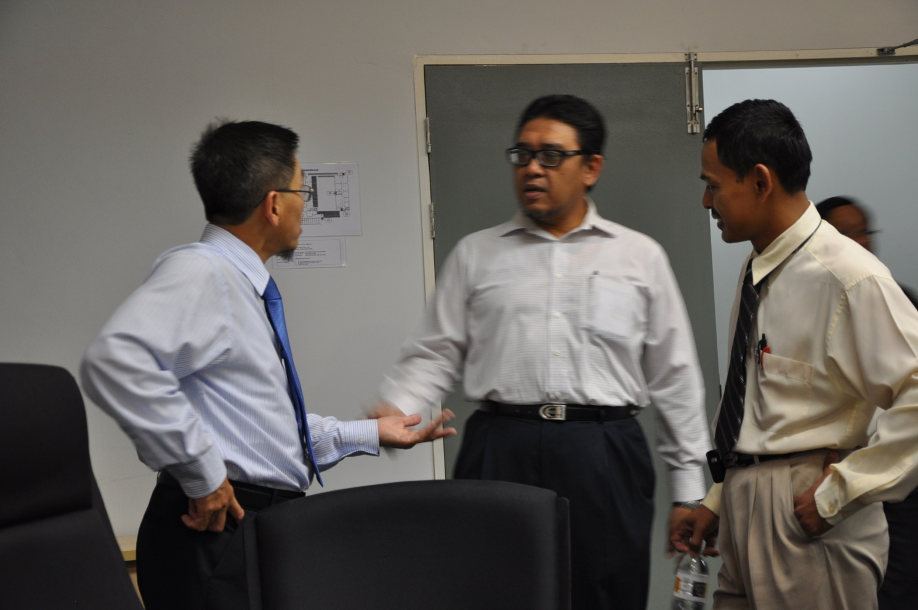
OBE leads to :
Improved learning
Increase in institutional effectiveness
Enhanced accountability

Slide 26
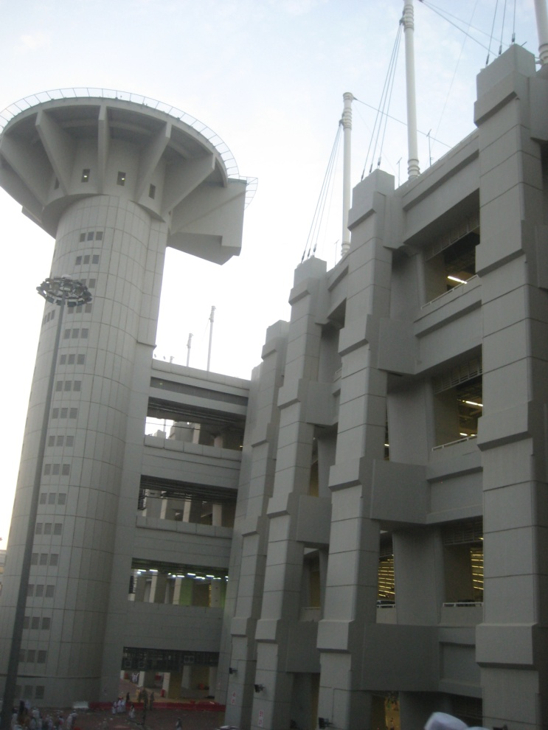
Strategy of OBE
Top down Curricula Design
Appropriate Teaching & Learning Methods
Appropriate Assessment & Evaluation Methods

Slide 27
Different Levels of Outcomes
Program Educational Objectives (PEO)
Few years after
Graduation – 4 to 5 years
Programme Outcomes (PO)
Upon graduation
Course/subject Outcomes (CO)
Upon subject completion
Weekly/Topic Outcomes
Upon weekly/topic completion

Slide 28
Linking Topics to Programme Educational Objectives (PEO)
Topics lead to learning objectives
Group/individual learning objectives lead to course outcome
Course outcomes must relate to programme outcomes
Programme outcomes must address the programme educational objectives (What kind of “engineers” to produce?)

Slide 29
Jargons
Objectives – Broad goals that address institutional and programme mission statements and are responsive to the expressed interest of the stakeholders
Outcomes – knowledge, skills and attitudes that directly address the objectives (desired attributes)

Slide 30
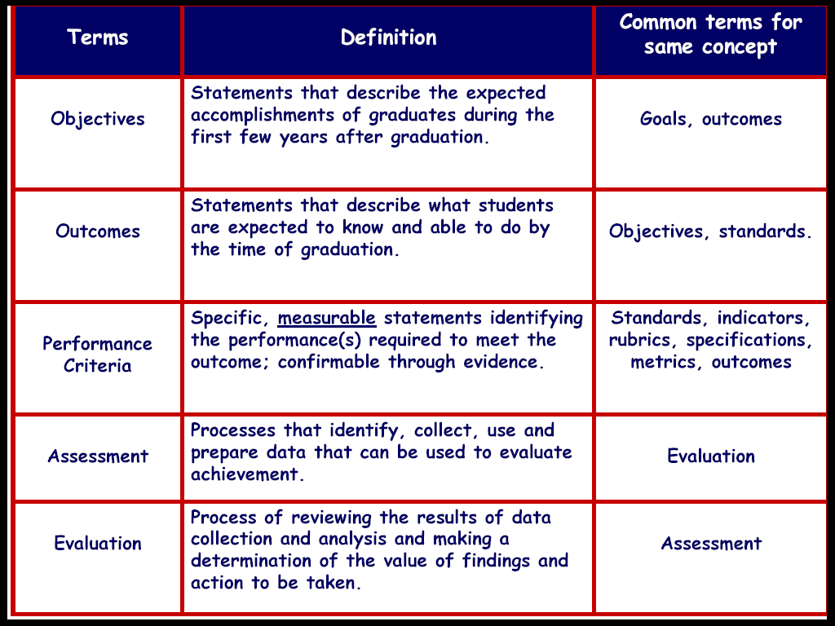

Slide 31
OBE addresses the following key questions:
What do you want the students to have or able to do?
How can you best help students achieve it?
How will you know what they have achieved it?
How do you close the loop

Slide 32
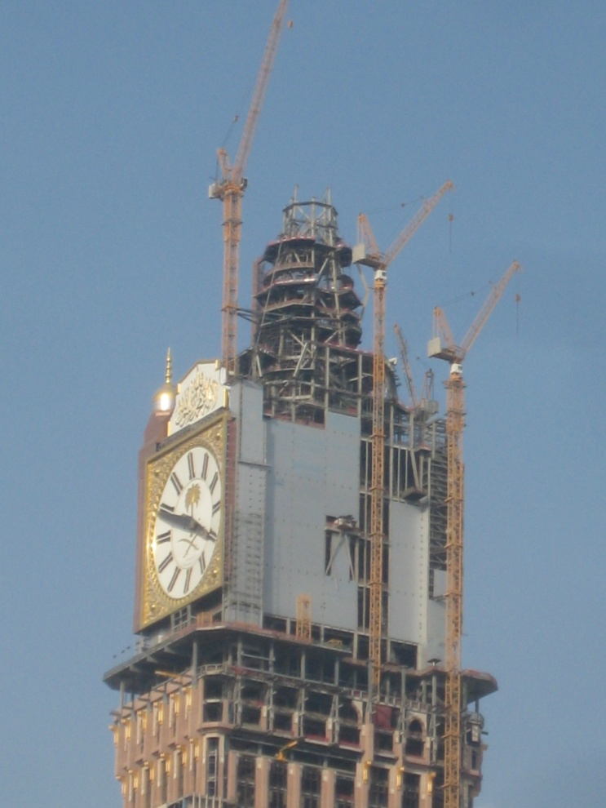
What do you want the students to have or able to do?
Cognitive Skills
Psychomotor Skills
Affective / Social Skills

Slide 33
How can you best help students achieve it?
Lectures, demonstration, laboratories
Projects (design, research) and field experience
Multimedia lectures and tutorials, interactive simulations, web based instruction
Writing, speaking assignments
Student centred learning

Slide 34

How will you know what they have achieved it?
Formative Assessment
Summative Assessment
Course Assessment
Programme Assessment
Assessment Tools
Direct and Indirect Assessments

Slide 35
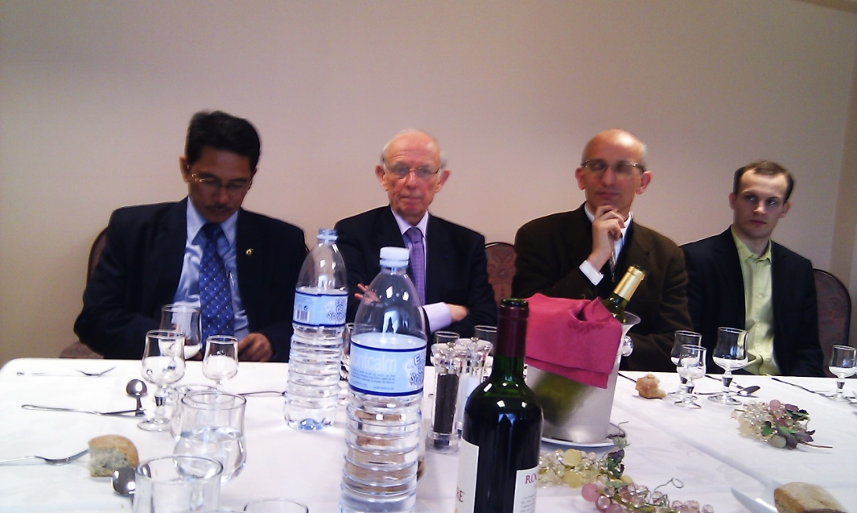
How do you close the loop ?
Assessment Plan
Who are doing what and when
Stakeholders participation
CQI in place

Slide 36

Issues on Implementation of OBE
Effective Programme Objectives (PEO)
Effective Programme Outcomes (PO).
Practical Assessment Tools.
Effective Assessment Plan.
Robust Evaluation Plan.
CQI procedures in place
Management Driven! Management Commitment!

Slide 37
Developing Curriculum Curricula (75 minutes)
10.45 – 12.00

Slide 38
Continual Improvement
Stakeholders’ requirements (Develop objectives)
Curriculum,
Staff &
Facilities
Teaching &
Learning
Graduates
with
Outcomes
Stakeholders’ satisfaction (Achieving objectives)

Slide 39

Developing OBE Curricula
Vision & Mission
Stakeholders Input
Malaysian Engineering Education Model
  Global & strategic
  Industrial
  Humanistic
  Practical
  Scientific
  Professional
SWOT Analysis

Slide 40
Professional Engineers
Engineers
Technologist
Others
ENGINEERING GRADUATES OUTCOMES

Slide 41
Professional Engineers
Engineers
Technologists
Others
PAE
+
3 Years Work Experience
(Normally > 5 yrs)
Register
with BEM
Register with BEM/MBOT upon graduation
Register with BEM
upon graduation
ENGINEERING GRADUATES OUTCOMES

Slide 42
ENGINEERING PROGRAMME
Education
(Knowledge & Understanding)
Training
(Skill)
Cognitive
(Knowledge – K)
Psychomotor
(Skill – S)
Affective
(Attitude – A)

Slide 43
Depth of Knowledge Required
Complex Problems | Broadly Defined Problems | Well defined Problems
Requires in-depth knowledge that allows a fundamentals-based first principles analytical approach
Requires knowledge of principles and applied procedures or methodologies
Can be solved using limited theoretical knowledge, but normally requires extensive practical knowledge

Slide 44

Institutional
Mission Statement
Stakeholders Interest
Programme Objectives
Programme Outcomes
(Knowledge, skills, attitudes of graduates)
Course Outcomes
(Ability to: explain, calculate, derive, design)
Assessment of Attainment Level
Continual Improvement

Slide 45
Educational Process - Stakeholders
Internal Stakeholders
Teachers
Students
University
Pull
factor
Programme EO / O Development/ Review
Specification
Course O / Content
Development / Review
1, 2, 3 ……
External Stakeholders
Potential Employers / Industry
Alumni
Regulatory Body
Course Implementation
1, 2, 3 ……
Internal Stakeholders
Teachers
Formative / Summative
Course Assessment
1, 2, 3 ……
Teacher – Knowledge, Skills, Affective
Students – Teaching
Teacher – Descriptive Self Assessment
on Cohort’s Achievement
Internal Stakeholders
Teachers
Technicians
Students
Internal Stakeholders
Teachers
Students
Programme Evaluation
Summative - direct
Exit Survey - indirect
Industry Survey - indirect
Alumni Survey - indirect
External - direct
Accreditation - direct
Summative
External Stakeholders
Potential Employers / Industry
Alumni
Regulatory Body
External Assessor

Slide 46
A
CQI
Programme
Outcomes
Course
Outcomes
Teaching Plan
CQI
1
Implementation
CQI
Contents
2
Levels
Contact Time
Cohort’s
Evaluation
Learning Time
3
Assessments

Slide 47
Intervention
for following year
5
Cohort’s
Evaluation
3
Summative
at year
4
Summative
4 years
6
A
CQI
Programme
Outcomes
Course
Outcomes
Other
Stakeholders
B

Slide 48
Curricula Models
Distribution of Knowledge, Skills & Attitude
elements throughout the 4 years
Yr. 4
S&A
30%
S&A
30%
Yr. 3
K 70%
K 70%
K 70%
K 70%
Yr. 2
S&A
30%
Yr. 1
S&A
30%
A
B
C
D

Slide 49
T
Model B: Greater emphasis on skills and attitude at the early years but lesser toward the middle years and back to greater emphasis near graduation
Stakeholders Input?
Semester 8
Semester 1
Skills &
Attitude
Knowledge
Development Concept of Outcome-based Education
1. Programmeme Educational Objectives
2. Programmeme Outcomes
EAC requirements
EAC requirements
Employers’ requirements
WA requirements
NGOs requirements
Faculties’ expectations
School’s vision and mission
MEEM requirements
Semester 8
Semester 1
Skills &
Attitude
Knowledge
3. Develop Curriculum Structure
4. Develop Course (Topic) learning outcomes
5. Develop Course outcomes
Model A: Equal emphasis on the knowledge, skills and attitude from the early years until graduation
Assessment and Evaluation for Continual Improvement

Slide 50
Programme Educational Objectives (PEO) (45 minutes)
12.00 – 12.45

Slide 51
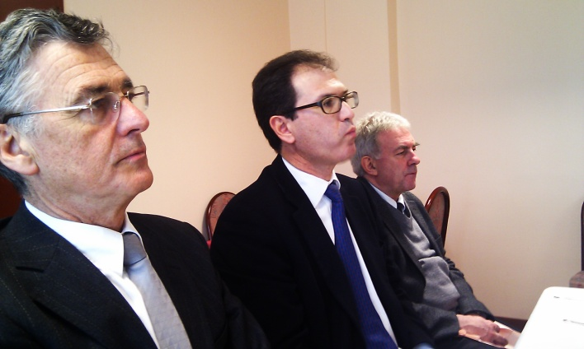
Accreditation Questions on PEO
How were the programme objectives determined?
Are they consistent with the institution missions?
How does the institution accomplish the objectives?
How is the review and update done?
How does the institution knows that the objectives are met?
Who are your stakeholders?
How are the stakeholders involved?

Slide 52
CHARACTERISTICS OF GOOD OBJECTIVE STATEMENTS
Should be stated such that a graduate can demonstrate in their career or professional life after graduation (long term in nature)
Distinctive/unique features/having own niche
Specific, Measurable, Achievable, Result oriented, and having a Time frame (SMART)
Clear, concise, consistent and reachable
Has clear link to the programme outcomes & curriculum design

Slide 53
eg. Programme Objectives (PEO)
To provide graduates with sufficient knowledge in civil engineering and possess the necessary skills for work in the industry.
To produce graduates who are sensitive and responsible towards the society, culture and environment.
To prepare graduates for work in advanced design and innovation at international level.

Slide 54
Exercise 1
List down potential stakeholders
Major
Minor

Slide 55
Exercise 2
Develop several programme objectives based on the kind of graduates your programme intent to produce

Slide 56
Programme Outcomes (90 minutes)
14.00 – 15.30

Slide 57

Programme Outcomes
What the graduates are expected to know and able to perform or attain by the time of graduation (skills, knowledge and behaviour/attitude)
There must be a clear linkage between Objectives and Outcomes
Need to distribute the outcomes throughout the programme, and not one/two courses only addressing a particular outcome

Slide 58
CHARACTERISTICS OF GOOD OUTCOME STATEMENTS
Each describes an area of knowledge and/or skills that a person can possess
Should be stated such that a student can demonstrate before or by the time of graduation
Should be supportive/responsive of/to one or more programme educational objectives (must be linked to the programme educational objectives)
Do not have to include measures or performance expectations

Slide 59
WA & EAC PROGRAMME OUTCOMES
WA1 | EA(i) | Engineering Knowledge | Breadth & depth of knowledge
WA2 | EA(ii) | Problem Analysis | Complexity of analysis
WA3 | EA(iii) | Design/Development of Solutions | Breadth & uniqueness of engineering problems i.e. the extent to which problems are original and to which solutions have previously been identified and coded
WA4 | EA(iv) | Investigation | Breadth & depth of investigation and experimentation
WA5 | EA(v) | Modern Tool Usage | Level of understanding of the appropriateness of the tool
WA6 | EA(vi) | The Engineer and Society | Level of knowledge and responsibility
WA7 | EA(vii) | Environment and Sustainability | Type of solutions
WA8 | EA(viii) | Ethics | Understanding and level of practice
WA10 | EA(ix) | Communication | Level of communication according to type of activities performed
WA9 | EA(x) | Individual and Team Work | Role in and diversity of team
WA12 | EA(xi) | Life-long Learning | Preparation for and depth of continuing learning
WA11 | EA(xii) | Engineering Project Management and Finance | Level of management required for differing types of activity
WA: Washington Accord Graduate Attributes EA: Engineering Accreditation Council Programme Outcomes

Slide 60
WA & EAC PROGRAMME OUTCOMES
WA1 | EA(i) | Engineering Knowledge | Breadth & depth of knowledge
WA2 | EA(ii) | Problem Analysis | Complexity of analysis
WA3 | EA(iii) | Design/Development of Solutions | Breadth & uniqueness of engineering problems i.e. the extent to which problems are original and to which solutions have previously been identified and coded
WA4 | EA(iv) | Investigation | Breadth & depth of investigation and experimentation
WA5 | EA(v) | Modern Tool Usage | Level of understanding of the appropriateness of the tool
WA6 | EA(vi) | The Engineer and Society | Level of knowledge and responsibility
WA7 | EA(vii) | Environment and Sustainability | Type of solutions
WA8 | EA(viii) | Ethics | Understanding and level of practice
WA10 | EA(ix) | Communication | Level of communication according to type of activities performed
WA9 | EA(x) | Individual and Team Work | Role in and diversity of team
WA12 | EA(xi) | Life-long Learning | Preparation for and depth of continuing learning
WA11 | EA(xii) | Engineering Project Management and Finance | Level of management required for differing types of activity
Engineering Knowledge | Apply knowledge of mathematics, science, engineering fundamentals and an engineering specialisation to the solution of complex engineering problems
Problem Analysis | Identify, formulate, research literature and analyse complex engineering problems reaching substantiated conclusions using first principles of mathematics, natural sciences and engineering sciences
Communication | Communicate effectively on complex engineering activities with the engineering community and with society at large, such as being able to comprehend and write effective reports and design documentation, make effective presentations, and give and receive clear instructi
Design/Development of Solutions | Design solutions for complex engineering problems and design systems, components or processes that meet specified needs with appropriate consideration for public health and safety, cultural, societal, and environmental considerations
Investigation | Conduct investigation into complex problems using research based knowledge and research methods including design of experiments, analysis and interpretation of data, and synthesis of information to provide valid conclusions
Modern Tool Usage | Create, select and apply appropriate techniques, resources, and modern engineering and IT tools, including prediction and modelling, to complex engineering activities, with an understanding of the limitations
The Engineer and Society | Apply reasoning informed by contextual knowledge to assess societal, health, safety, legal and cultural issues and the consequent responsibilities relevant to professional engineering practice
Engineering Project Management and Finance | Demonstrate knowledge and understanding of engineering and management principles and apply these to one’s own work, as a member and leader in a team, to manage projects and in multidisciplinary environments
Life-long Learning | Recognise the need for, and have the preparation and ability to engage in independent and life-long learning in the broadest context of technological change
Individual and Team Work | Function effectively as an individual, and as a member or leader in diverse teams and in multi-disciplinary settings
Environment and Sustainability | Understand the impact of professional engineering solutions in societal and environmental contexts and demonstrate knowledge of and need for sustainable development
Ethics | Apply ethical principles and commit to professional ethics and responsibilities and norms of engineering practice
WA: Washington Accord Graduate Attributes EA: Engineering Accreditation Council Programme Outcomes

Slide 61
Programme Outcomes cont…
Assessment process and documented evidence
  Anecdotal vs measured results
  Reliance on course grades only
  Over-reliance on self-assessment (survey)
  Plan available but not implemented

Slide 62
Exercise 3
Discuss on the different Programme Outcomes required by your programme, and briefly explain how can they be measured.

Slide 63
Course Outcomes (75 minutes)
15.45 – 17.00

Slide 64
Course Development
Content - typical stuff
Learning (Topic) Outcomes - teaching plan
Course Outcomes - group of learning (topic) outcomes
CO-PO matrix – is it satisfactory?
Things to consider
Depth – e.g.Bloom’s taxonomy
Delivery and assessment
Students’ time and competencies covered

Slide 65

Creating a Course
Planning
  Identify course content and defining measurable learning outcomes
Instruction
  Select and implement methods – deliver the specified content and facilitate student achievement of the outcomes
Assessment and Evaluation
  Select and implement methods – determine how well the outcomes have been achieved

Slide 66
Course Outcomes – derived from Teaching Plan
Topics – to be grouped in weekly or hourly (could be according to activity)
Learning outcomes for each topic – specific and measurable
Delivery methods – indicate if they are Lecture, PBL, Case Method, site visit etc.
Hours - Contact hours between lecturer-students, Student learning hours and lecturer grading/ advising hours
Assessment – indicate on how and where the learning outcomes will be measured (for course evaluation)
Course outcomes – group the learning outcomes into several course outcomes.
Map Course Outcomes to Programme Outcomes
Bottom Up Approach

Slide 67
Course to Programme Outcomes Mapping

Slide 68
Course Outcomes (CO) Contribution to Programme Outcomes (PO)
Ability to function in multidisciplinary team
Assign multidisciplinary design projects in 1st year engineering courses.
Implement senior design projects with multidisciplinary teams
Simulate multidisciplinary teamwork in Final year design projects

Slide 69
Course Outcomes (CO) Contribution to Programme Outcomes (PO)
Broad education necessary to understand the impact of engineering solutions in a global, environment and societal context + knowledge of contemporary issues
Include one or two structured controversies in engineering course
Include instructional materials, written student products in course portfolio
Put in some class exercises and homework problems that involve global/societal issues in several engineering courses, including 1st year engineering and capstone design courses

Slide 70
Course Outcomes (CO) Contribution to Programme Outcomes (PO)
Life Long Learning
Teach students about learning styles and help them identify the strength and weakness of the their styles and give them strategies to improve
Use active learning methods to accustom them to relying on themselves
Give assignments throughout the programme year that require library and www searches
Anything done to fulfil criteria on: understanding ethical and professional responsibility and understanding societal and global context of engineering solutions, will automatically satisfy this criterion

Slide 71

Some Current Issues for Educators
Learning
      Prescriptive: Students would be exposed to the C language – what is taught
      as compared to the OBE approach
      Outcomes : Students should be able to make use of the C language in programming – what is learned

Slide 72
3 Components of a learning outcome
1) Action verb
Ability to:
describe the principles used in designing X.
evaluate the strengths and weakness of …
Well-written verbs must be
(SMART)
Specific
Measurable
Achievable
Realistic
Time frame
Observable
Try to avoid these:
- understand
- appreciate
know
learn
aware
familiar

Slide 73
3 Components of a learning outcome
2) Condition (context under which the behaviour is to occur)
describe the principles used in designing X.(V)
orally describe the principles used in designing X. (V&C)
design a beam. (V)
design a beam using Microsoft Excel design template . (V&C)

Slide 74
3 Components of a learning outcome
3) Standard (criteria of acceptable level of performance)
describe the principles used in designing X.(V)
orally describe the principles used in designing X. (V&C)
orally describe the five principles used in designing X. (V&C&S)
design a beam. (V)
design a beam using Microsoft Excel design template . (V&C)
design a beam using Microsoft Excel design template based on BS 5950:Part 1. (V&C&S)

Slide 75
Why are course outcomes important?
They are essential because they:
define the type and depth of learning students are expected to achieve
provide an objective benchmark for formative, summative, and prior learning assessment
clearly communicate expectations to learners
clearly communicate graduates’ skills to the stakeholders
define coherent units of learning that can be further subdivided or modularized for classroom or for other delivery modes.
guide and organize the instructor and the learner.

Slide 76
Learning outcomes by adding a condition and standard
Poor
Students should be able to design research.
Better
Students should be able to independently design and carry out experimental and correlational research.
Best
Students should be able to independently design and carry out experimental and correlational research that yields valid results.
Source: Bergen, R. 2000. A Program Guideline for Outcomes Assessment at Geneva College

Slide 77

Learning Outcomes
Statement … explain, calculate, derive, design, critique.
Statement … learn, know, understand, appreciate – not learning outcomes but may qualify as outcomes (non-observable).
Understanding cannot be directly observed, student must do something observable to demonstrate his/her understanding.

Slide 78
Checklist for writing learning outcomes
Focus on outcomes, not processes
Start each outcome with an action verb.
Its good to use only one action verb per learning outcome
Avoid vague verbs such as know and understand.
Check that the verbs used reflect the level of learning required.
Ensure that outcomes are observable and measurable.
Write the outcomes in terms of what the learner does, not what the instructor does.
Check that the outcomes reflect knowledge, skills, or attitudes required in the workplace.
Include outcomes that are woven into the entire course (such as work effectively in teams).
Check that there are the appropriate number of outcomes (no more than three per major topic)
List the sub-outcomes for each outcome
Check that the outcomes fit within programme and course oucomes

Slide 79
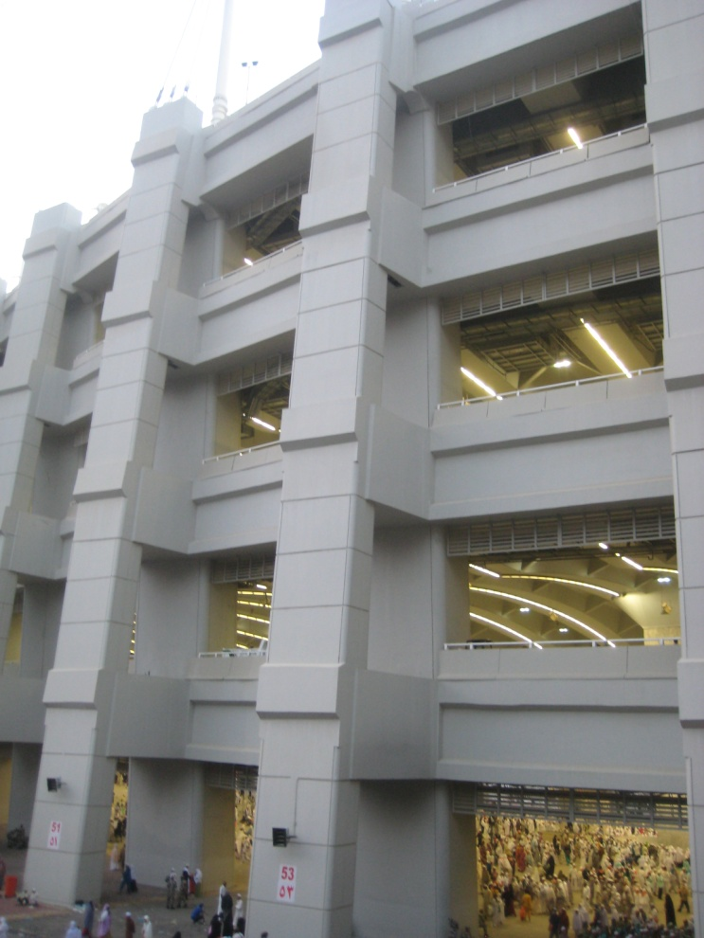

Teaching Plan
Plan-do-check-act (PDCA)
Plan the class of 42 hours, if teaching a 3 credit course

Slide 80
What to consider when preparing a teaching plan?
From each topic – what is the learning outcomes
Remember – something that you can measure (think about assessment tools)
Do your learning outcomes address your course outcomes and programme outcomes?
Consider students’ contact hours

Slide 81
Cont….
Consider class or instructor contact hours
Identify delivery methods
A delivery method can address many outcomes but remember you must know how to assess at the end
What do you want the students to do in order to learn?
What are the preparations that an instructor has to do to ensure learning?

Slide 82
Cont…
Write an executive summary of how you are going to facilitate learning in your course (remember you must be able to demonstrate that learning has taken place)
The assessment (exam, test, quiz) questions, assignments, and observations (what you can observe you can measure) should be expanded further.

Slide 83
Cont….
You will need to know the students in order to be able to observe and record students participation

Slide 84
Typical teaching plan format
Remember KSA
Topics | Course outcome | Delivery method | Assessment | Indicator | Students contact time | Instructors contact time

Slide 85
Exercise 4
Identify a course and produce several learning outcomes
Propose a matrix of course outcomes and map against your programme outcomes

Slide 86
Exercise 5
Write a brief executive summary of how you are going to facilitate learning in your course (remember you must be able to demonstrate that learning has taken place)

Slide 87
Exercise 6
Scenario
Pakistan New University (PNU) decided to start a new “general” engineering programme (Bac of Eng) in addition to the existing two programmes. The existing programmes have only one common programme educational objective, i.e., “to produce engineers (according to the related field). The team which includes you is responsible to develop the new programme, and had decided to expand the programme objectives to include
  Global player
  Leading in advanced design

Slide 88
Questions
Identify the appropriate POs for the new programme, and link them to the PEOs
Identify the suitable taxonomy level for the respective POs.
A course, Strength of Materials has been identified as a fundamental course for the new programme. Develop the course outcomes and identify the appropriate taxonomy level.

Slide 89
Questions
Azlan’s section to address this !
How would you assess the course’s cognitive outcomes?
If you have to include non-cognitive outcomes, what are the possible assessment techniques to be employed?
Establish a mechanism to demonstrate attainment of the course outcomes (both formative and summative)
Show how the course outcomes contribute to the programme outcomes.

Slide 90


Thank you
End of Day 1

Slide 91

Delivery & Assessment
Day 2
Azlan Abdul Aziz PEng, MMSET, MIEM
Director, Engineering Accreditation Department, Board of Engineers Malaysia

Slide 92
Day 2 Outlines
Learning Styles
Delivery / Pedagogy
Assessment
Observation
Rubrics
Assessment Report
Interviews

Slide 93
Learning Styles (30 minutes)
09.00 – 09.30

Slide 94


Learning Style Model
Perception Sensing Intuitive
Input Modality Visual Verbal
Processing Active Reflective
Understanding Sequential Global

Slide 95
Sensor & Intuitor
SENSOR – favours information that comes in through their senses. Attentive to details and do not like abstract concepts. Like well-defined problems that can be solved by standard methods
INTUITORS – favours internally generated information (memory, conjecture, interpretation). Can handle abstraction and bored by details. Prefer problems that call for innovation.

Slide 96
Approach
Professors are mostly intuitors, who emphasise basic principles, mathematical models and thought problem
Engineering students are mostly sensors, favour observable phenomena, hard facts, problems with well defined solution methods
Thus the disparity between the teacher and the learner

Slide 97
Learning and Teaching Styles
SO WHAT?
Mismatch between learners & teachers. Teachers usually intuitors but learners can be any of the 4 types.
WHAT TO DO?
Include various active teaching techniques to address ALL learning styles centered on the students i.e. Student Centered Learning (SCL)

Slide 98

Sensing (S) Learning | Intuitive (N) Learners
Focus on external input (see, hear, taste, touch, smell) | Focus on internal input (thoughts, memories, image)
Practical | Imaginative
Observant (notice details of environment) | Look for meanings (miss detail)
Concrete thinking (facts, data, hands-on-work) | Abstract thinking (theories, math model)
Learn through repetition (drills, numerous examples, replication of experiments) | Like variety in learning experiences (bored with repetition)
Methodical | Quick
Like working with details | Like working with concepts
Complaint about courses: No apparent connection to real world | Complaint about courses: “Plug & Chug” (Lots of memorization, repetitive formula substitution)
Problem with exams: Run out of time | Problem with exams: Careless mistakes

Slide 99

Visual (Vs) Learners | Verbal (Vb) Learners
“Show me” | “Explain it to me”
- pictures | - spoken words
- diagrams | - written words, symbols (seen, but translated by brain into their Oral equivalents)
- sketches
- schematics
- flow charts
- plots

Slide 100


Active (A) Learners | Reflective (R) Learners
Tend to process actively (doing something physical with presented material, then reflecting on it) | Tend to process reflectively (thinking about presented material, then doing something with it)
Think out loud | Work introspectively
“let’s try it out and see how it goes” | “Let’s think it through and then try it”
Tend to jump in prematurely | Tend to delay starting
Like group work | Like solo or pair work

Slide 101

Sequential (Sq) Learners | Global (G) Learners
Built understanding in logical sequential steps | Absorb information randomly, then synthesize the big picture
Function with partial understanding of information | Need the big pictures (interrelations, connections to other subjects and personal experience) in order to function with information
Make steady progress | Large leaps in understanding with little progress between them
Explain easily | Can’t explain easily
Good at analytical thinking (the trees) | Synthesis, holistic thinking (the forest)

Slide 102

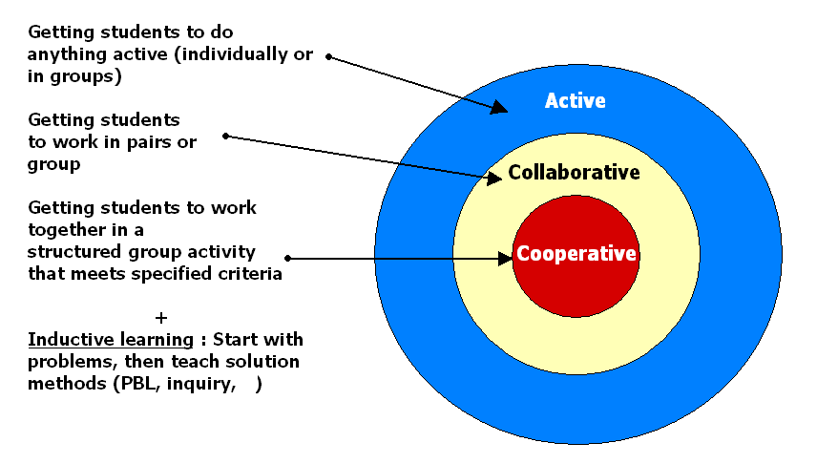
Student-Centered Learning

Slide 103
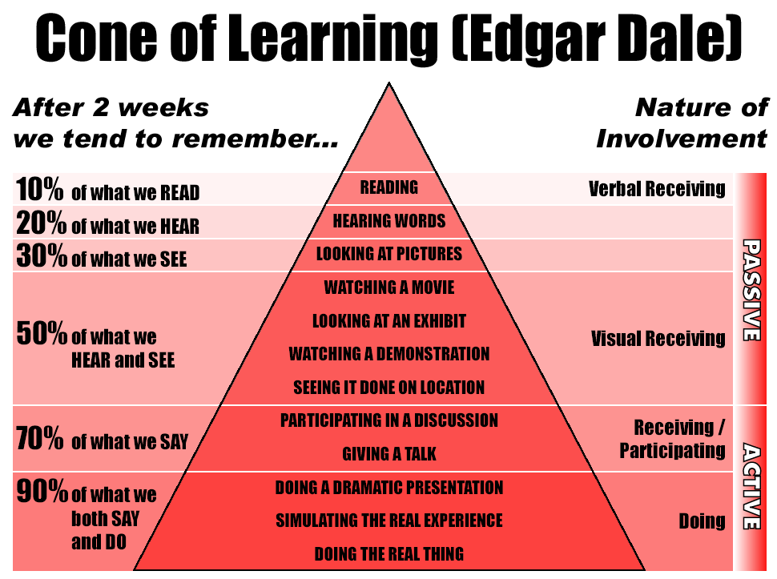

Slide 104
Delivery / Pedagogy (2 hours)
09.30 – 10.30
10.45 – 11.45

Slide 105

Lecture Method
Lecture has its limitation in that it is usually one-way
Lecture method – the faculty must master and communicate
A lecturer may not know the depth of his students’ thinking apart from tests and examinations
Lecture provides immediate problem solving

Slide 106

Socratic Concept
Knowledge originates from the pupils through the skillful questioning of the teacher

Slide 107
Case Method
Case method is typically applied for graduate supervision or teaching a small group seminar/class at many places
Harvard Business School, however, has classes up to 180 pupils and organises its teaching through (10%) lectures and (90%) cases

Slide 108
Case Method – cont…
It includes small group, buzz group and large group discussion and a variety of other approaches that enable wide engagement between students and instructor
The faculty must master, communicate and also manage classroom process
Educates students to think creatively about the field and master it

Slide 109
Case Method – cont…
It requires the instructor to have a flexible plan
The faculty is the master and can also be a learner
Modesty of the instructor is a requirement
May include internet/online to supplement teaching

Slide 110
Case Method – cont…
The rule is not to embarrass anybody in the class
Need to manage the “process” by calling individuals to present or open, ask for volunteer, get sections to appoint spokesman ….
A good case raises good questions for the students to address

Slide 111

What is a Case?
Description of an actual situation
Commonly involving a decision, a challenge, an opportunity, a problem or an issue faced by a person/organization
A print form, film, video, CD etc
Field-based – visits, collect data, interview

Slide 112

Cases
Carefully thought-out process
With specific teaching objectives
Not all information is available
Date and location may imply the economic, social, political and technological context

Slide 113

Armchair Cases
Problem, exercise, article, simulation are different from cases – may not use real life data and obtained a release

Slide 114

Why are cases used?
Learn by doing and teaching others
Repetitive opportunity to identify, analyse and solve a number of issues in a variety of settings – prepares students for work
Allows to take the role of a specific person/organisation – real life situation

Slide 115

Why are cases used? Cont….
Practice on real thing harmlessly
A tool to test the understanding of theory, connect theory with application, and develop theoretical insights
Cases provide information about how work is planned and organised in various settings, how systems operate and how organisation compete

Slide 116

Why are cases used? – cont….
Access to information may be limited as in real life, helps to tolerate incompleteness
Discussion based format also provides self confidence, ability to think independently and work cooperatively
Cases engage students in the process of learning

Slide 117

Skills developed from Case Method
Analytical – qualitative and quantitative frameworks to analyse, problem identification, data handling, critical thinking – carefully sifting data
Decision making – generate alternatives, select decision criteria, evaluate alternatives, formulate implementation plans

Slide 118

Skills developed from Case Method – cont…..
Application – opportunity to practice using tools, techniques, and theories the students had learned
Oral communication – Listening, expressing, construct argument and convince a view – learning to think on your feet, consider other viewpoints and defend positions

Slide 119

Skills developed from Case Method – Cont…..
Time management – schedule educational activities within a time constraint
Interpersonal – discussion allows learning how to deal with peers – conflict resolution, compromise
Creative – invites imagination in problem solving, as there are multiple solutions
Written communication – note taking, case report, case exam

Slide 120
Problem-based Learning
Difference between problem-based learning and case method is not much as both pose problem but case looks for feasible solutions (not single answer) and identify the best

Slide 121

PROJECT/PROBLEM BASED
Project (design) oriented organised from first year
  Deals with know-how problems
  Solved by theories and knowledge from lectures
Problem oriented
  Deals with unsolved problems
  Within science and engineering
  Know-why approach
  Supported by relevant lectures

Slide 122
Curriculum
50% devoted to project work
25% to courses related to the project
25% to courses related to the curriculum
Theme – increase knowledge, broad range of subjects, professional input

Slide 123
Lecture & Project
Introduction
Evaluation
Course
Project work

Slide 124
Problem organised project work
Lectures
Group Studies
Literature
Problem Analysis
Problem Solving
Report
Tutorials
Field Work
Experiment

Slide 125
Requirements
High degree of supervision
Office space
Lectures to be constantly changing or renewed
Flexibility in the distribution of resources

Slide 126
Graduates
AALBORG UNIV
Strong in problem solving
Communication
Cooperation
General technical knowledge
TECHNICAL UNIV
Specialist knowledge
Technical methodology

Slide 127
Chinese Proverb
Tell me and I will forget
Show me and I will remember
Involve me and I will understand
Step back and I will act

Slide 128
Instructors/Supervisors
Pedagogical skills
Scientific skills
Time management
Project based on staff research

Slide 129

Requirements for the students
Active role – must come prepared for each class; contribute by teaching others, actively participating, taking risks, learning from instructor/classmates
Ethics – respect, trust and openess
Committed to learning – continual improvement

Slide 130
Assessment (2 hours)
11.45 – 12.45
14.00 – 15.00

Slide 131
ASSESSMENT:
Processes that identify, collect, use and prepare data for evaluation of achievement of programme outcomes or educational objectives.
EVALUATION:
Processes for interpretation of data and evidence from assessment practices that determine the program outcomes are achieved or result in actions to improve programme.

Slide 132
Assessment
drives learning (necessary evil!)
is formative or/and summative; to demonstrate student’s competence in demonstrating a specific outcome
is the process that identify, collect, use and prepare data that can be used to evaluate attainment.

Slide 133
What to Assess/Measure?
Delivery Method
Lecturer’s Attribute
Learning Environment
Assessing Student/Cohort (Course Outcome)
Assessing Student/Cohort (Programme Outcome)

Slide 134

Expectations from Evaluators on Assessment
Course Assessment links to Course Outcomes / Programme Outcomes
Formative Assessment
Summative Assessment
Looking for content breadth & depth from direct assessment
Looking for students ability to attain the highest level (depth)

Slide 135
Lessons learnt from accreditation activities related to assessment
Does not know the teaching plan
Done without referring to the plan
Does not know how to translate plan into assessment
Assessing at low-medium level (not challenging)
No feedback to students except at end of semester
Does not know how to relate assessment to expected outcomes
Repetition
Bulk marking
Traditional assessments

Slide 136
Assessment & Evaluation
Course | Programme Outcome 1 | Independent Variables
Outcome 1 | Yes (1)/ No (0) | Male / Female, PBL / Case Method ….
Outcome 2 | Yes (1)/ No (0)
Outcome 3 | Yes (1)/ No (0)
Outcome 4 | Yes (1)/ No (0)

Slide 137
Assessment tools
Exit surveys, Exit interviews (P)
Alumni surveys and interviews (P)
Employer surveys and interviews (P)
Job offers, starting salaries (relative to national benchmark) (P)
Admission to graduate schools (P)
Performance in group and internship assignments and in PBL situation (P,C)
Assignments, report and tests in capstone design course (P,C)
Standardized tests (P,C)
P: programme C: Course

Slide 138
Assessment tools cont….
Student surveys, individual and focus group interviews (P,C)
Peer-evaluations, self evaluations (P,C)
Student portfolios (P,C)
Behavioral observation (P,C)
Written tests linked to learning objectives (C)
Written project reports (C)
Oral presentation, live or videotape (C)
Research proposals, student-formulated problems (C)
Classrooms assessment Techniques (C)

Slide 139
Course Coverage & Assessment
When assessing, an instructor must consciously assess and evaluate the applicable elements (Knowledge, Skills, Attitude). An activity may be used to examine all the three elements
Model A
Model B
Domain
Domain
Knowledge
Knowledge
Skills
Skills
Attitude
Attitude

Slide 140
COURSE COVERAGE
Breadth of coverage is subject to the required outcomes,
Knowledge (K) = 70%, Skills (S) = 20%, Attitude (A) = 10%
K
(70%)
S
(20%)
A (10%)
3
3
3
3
3
3
3
3
3
2
2
2
2
2
2
1
1
1
1
1
Depth of coverage is subject to the required level of outcomes,
1(slight), 2 (moderate) or 3 (substantial)
COURSE ASSESSMENT

Slide 141
Assessment
Written project report, 50 – 150 pgs
Defended by the group
Internal monitoring
External examiner
Traditional exam

Slide 142
Assessing & Evaluating Course Outcomes
Let us look at some examples in assessment:
  Nutrition
  Natural Science

Slide 143
Course Outcomes (CO) -NUTRITION
CO: Children know the importance of washing their hands before eating as well as how to properly wash their hands
Use observation in assessment
At specified times during the 2 weeks following the session on hand washing, teachers recorded which children spontaneously washed their hands when it was time for a snack

Slide 144
Course outcomes (CO) - Natural Science
CO: Able to draw life cycle of a salmon
Ask to make drawings of the salmon's life once before the session, on the salmon's lifecycle and again at the end of the session
Changes in the details of the two drawings provide a demonstration of what had been learned

Slide 145
Outcome-based Assessment
Implementation Strategy | Assessment Strategy | Data Sources/Assessment instruments
Industrial project Improve student competence in communication, teamwork, and project management | Exams, interview, survey, observe, assess skill level, monitor development of skills | Reports, interview schedule, survey, observation records, grades of exams and projects, exit skill checklist
Design course Address industry needs | Assessment criteria from literature, by industry, and lecturers | List of assessment criteria, observation, reports, interview, students evaluation, exams, exit skill checklist

Slide 146
Performance Criteria/ Indicators
- Good Teamwork
Students are able to demonstrate
1. Positive contribution to the team project (minutes of meeting)
2. Well prepared and participate in discussion (observation)
3. Volunteer to take responsibility
4. Prompt and sufficient attendance
5. Aplomb and decorum

Slide 147
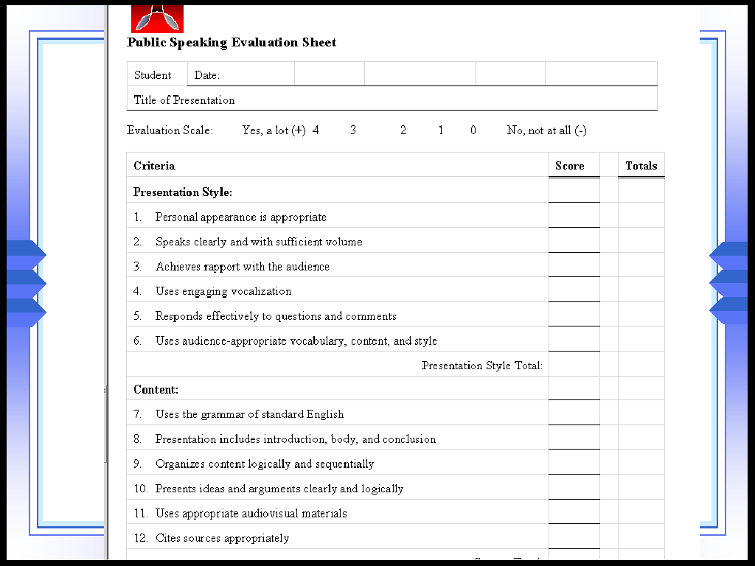
Performance Criteria/ Indicators – Public Speaking

Slide 148
Bloom’s Taxonomy
Knowledge (list)
Comprehension (explain)
Application (calculate, solve, determine)
Analysis (classify, predict, model,derived)
Synthesis (design, improve)
Evaluation (judge, select, critique)

Slide 149
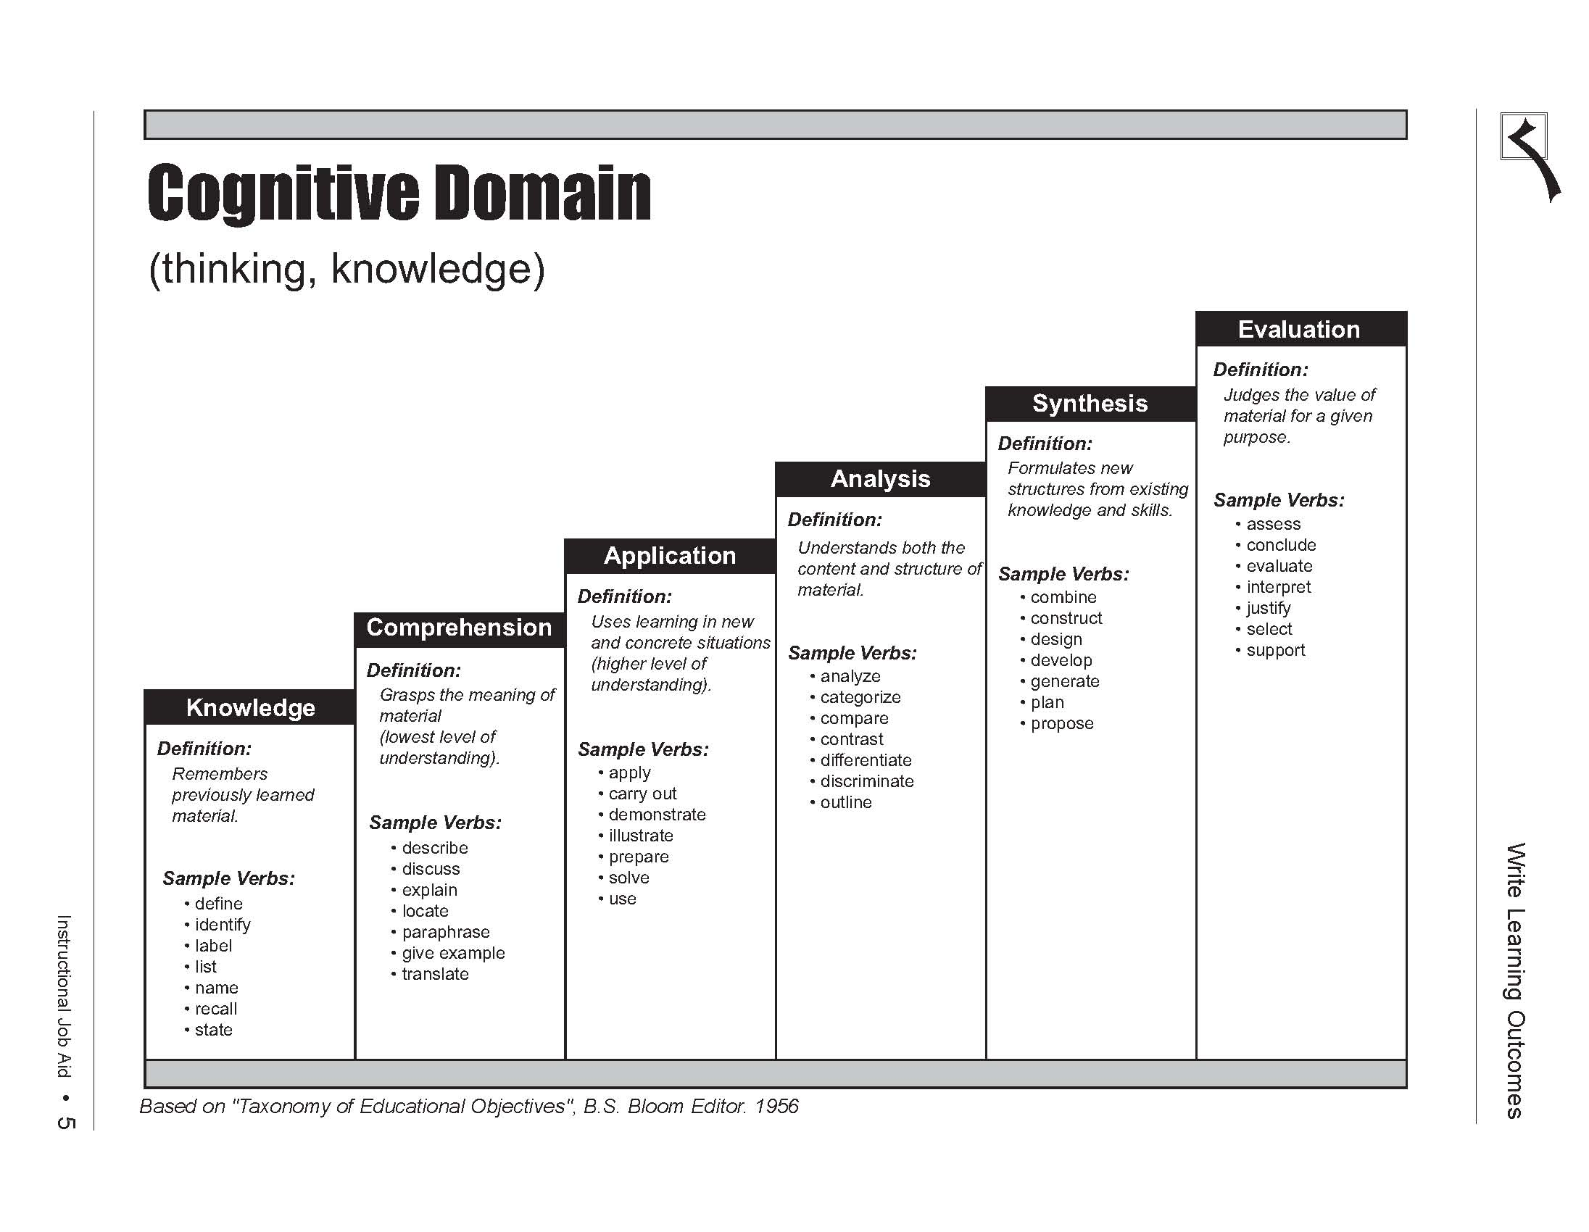
lower order
Intermediate
Higher order

Slide 150
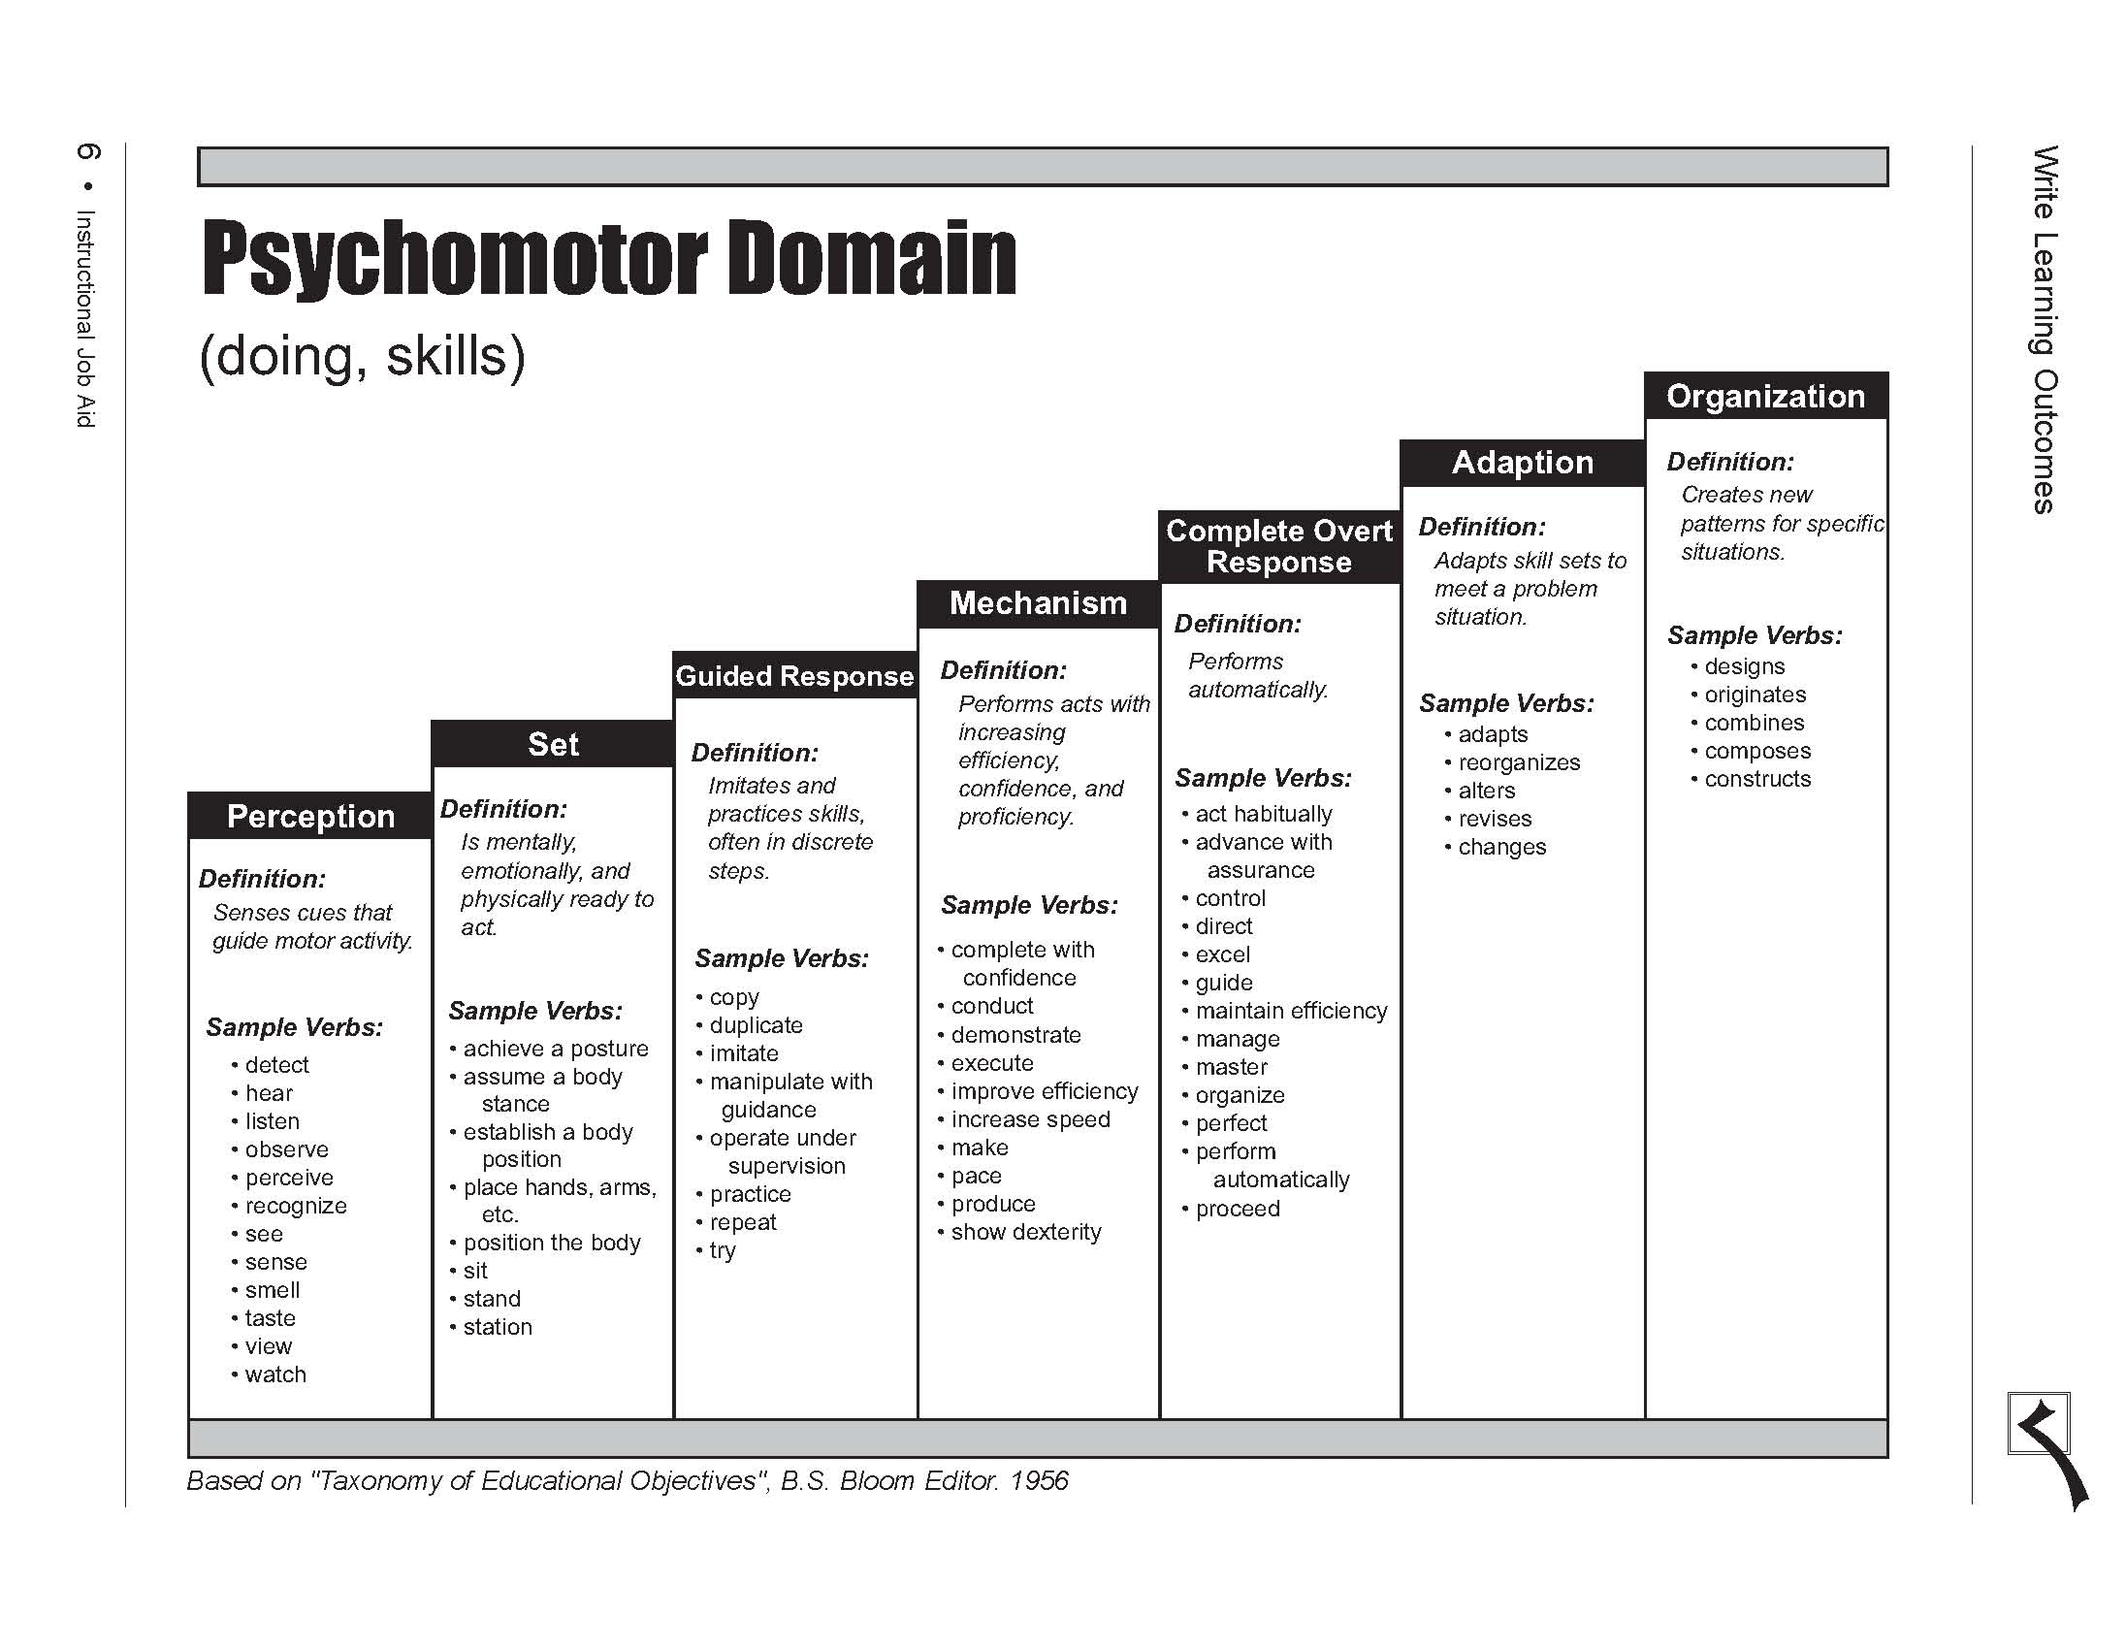
lower order
Intermediate
Higher order

Slide 151
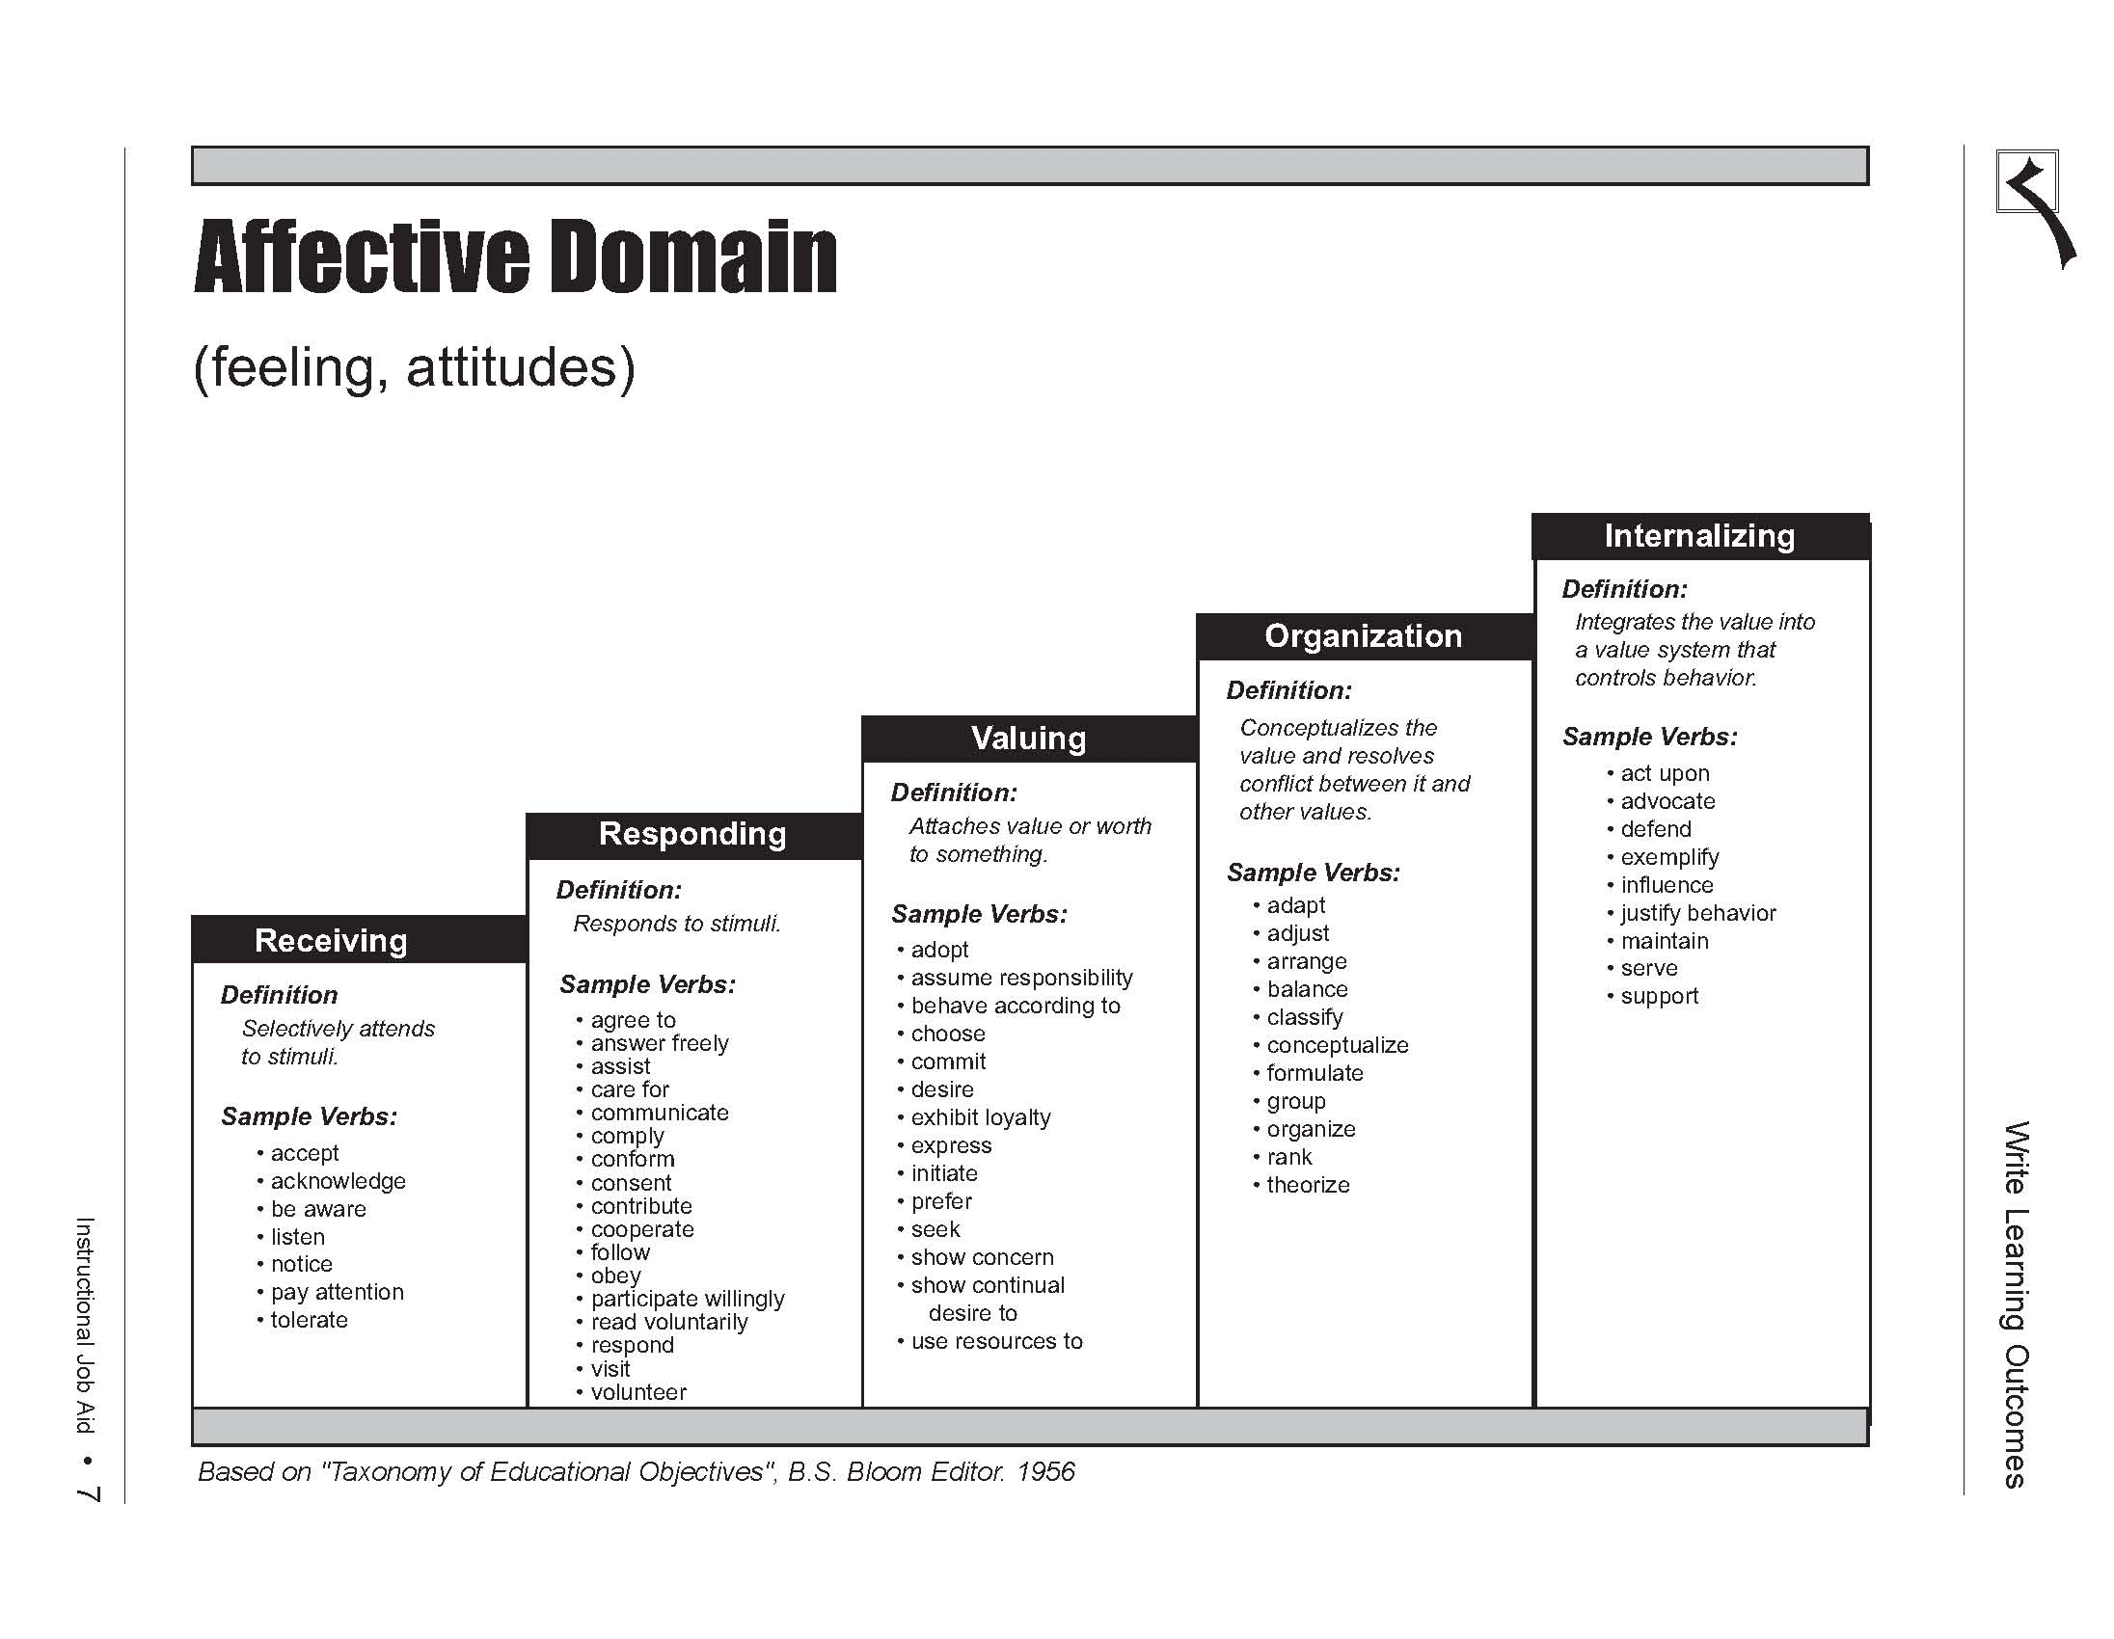
lower order
Intermediate
Higher order

Slide 152
Programme Outcome Assessment Matrix
Outcome indicators & core courses | Outcome 1 | Outcome 2
Project Report | A | B
Course 1 | B | B
Course 2 | C | B
A: slightly, B: moderately, C:substantively - base on a review of course materials (syllabus, learning outcomes, tests, other assessment…..)
Outcome 1: ability to …..
Outcome 2: ability to …..

Slide 153
Course Assessment Matrix
Outcome-related learning objectives | Outcome 1 | Outcome 2
Explain | A | C
Perform calculation | B | B
Identify | B | B
Solve | B | C
A: slightly, B: moderately, C:substantively
Outcome 1: ability to …..
Outcome 2: ability to …..

Slide 154
Observation (15 minutes)
15.00 – 15.15

Slide 155
What skills do observers need?
Ability to take in what is seen, heard, and felt in an event, and to report those impressions and details clearly in writing.
Someone with good attention and writing skills is more likely to assemble a useful observation report than someone who struggles with these tasks.

Slide 156
Write notes / capture
Students working in a small group might talk excitedly while working out the solution to a problem
Recording their comments can provide valuable testimonial to the benefits of cooperative learning
Audiotapes, videotapes, or photographs may prove useful in capturing the essence of observed events

Slide 157
Observing
Be attentive and open to discovering behaviours, both verbal and nonverbal, that suggest the presence or lack of student motivation
Observations alone are not sufficient evidence for convincing others that a programme has caused lasting change (eg. observations of students working with each other during a 20-minute activity do not necessarily mean that students are more inclined to work cooperatively in general)
It is always important to look for several sources of evidence that support whatever changes you think have occurred in students

Slide 158
Indicators of student interest
How many students are participating in the discussion?
    What are they saying?
How do students look? Are they distracted or bored, or are they listening with interest?
How much personal experience do the students bring into their responses?
How excited do they seem about the subject?
    What do they say?

Slide 159
Know the student
You will need to know the students in order to be able to observe and record students participation

Slide 160
Rubrics (30 minutes)
15.15 – 15.30
15.45 – 16.00

Slide 161
Unified key outcomes
Allow lecturer to decide on the criteria/indicator
Provide a standard and calibration
Get definition (perception from lecturer) and then standardise the definition

Slide 162
Rubric
It is a working guide for students and teachers, usually handed out before the assignment begins in order to get students to think about the criteria on which their work will be judged.
Authentic assessment tool which is designed to simulate real life activity where students are engaged in solving real-life problems.

Slide 163
Rubrics - What are they good for?
It is a set of categories developed from the performance criteria that define and describe progression toward meeting important components of work being completed, critiqued, or assessed.
Each category contains a gradation of levels of completion or competence with a score assigned to each level and a description of what performance criteria need to be met to attain the score at each level.

Slide 164
3 common features of rubrics
focus on measuring a stated objective (performance, behaviour, or quality).
use a range to rate performance.
contain specific performance characteristics arranged in levels indicating the degree to which a standard has been met (Pickett and Dodge).

Slide 165
Rubric
Adopted from G.Rogers
 | 4 - Exceeds Criteria | 3 - Meets Criteria | 2 - Progressing to Criteria | 1 - Below Expectations
Content | Provides ample supporting detail to support solution/ argument | Provides adequate supporting detail to support solution/ argument. | Some details but may include extraneous or loosely related material. | Inconsistent or few details that may interfere with the meaning of the text.
Organization | Organizational pattern is logical & conveys completeness & wholeness. | Organizational pattern is logical & conveys completeness & wholeness with few lapses. | Little completeness & wholeness, though organization attempted. | Little evidence of organization or any sense of wholeness & completeness.
Style | Uses effective language; makes engaging, appropriate word choices for audience & purpose. | Uses effective language & appropriate word choices for intended audience & purpose. | Limited & predictable vocabulary, perhaps not appropriate for intended audience & purpose. | Limited or inappropriate vocabulary for the intended audience & purpose.
 | Consistently follows the rules of standard English. | Generally follows the rules for standard English. | Generally does not follow the rules of standard English. | Does not follow the rules of standard English.

Slide 166

Types of Rubrics
An analytic rubric provides specific information about student performance on any given performance criterion.
A holistic rubric is broad in nature and provides information about the overall, general status of student performance (instead of creating separate categories for each criterion, the criteria are grouped under each level of the rubric).
A generic rubric can be used across a variety of activities where students get an opportunity to demonstrate their performance on an outcome (e.g., communication skills, where it could be used in a writing course or a design course).
A task-specific rubric is developed with a specific task in mind (focused and would not be appropriate to use outside of the task for which it was designed).

Slide 167
Rubric Scoring
The use of rubrics when scoring student work provides the programme with valuable information about how students are progressing and also points to specific areas where students need to improve.
  For example, when a staff member is grading a student’s paper, he/she can also score the paper for the student’s writing skills using the rubric provided.
  The scores obtained by each student can be aggregated and used for programme assessment.

Slide 168
Levels?
How many points (levels) should a rubric have?
It is important to consider both the nature of the performance (complexity) and the purpose of the scoring.
If the rubric aims to describe student performance at a single point in time, then three to five points are recommended.
If student performance is to be tracked over time and the focus is on developmental growth, then more points are needed.
Remember, the more points on the scale, the more difficult it is to get multiple raters to agree on a specific rating.

Slide 169
Effective Rubrics
For programme assessment, the most effective rubrics (generally speaking) are analytic, generic, and the use of a three- to five-point scale.
Good websites designed to help with the development of rubrics. http://edtech.kennesaw.edu/intech/rubrics.htm.
Many examples of rubrics on the web, but just because they are on the web, it doesn’t mean they’re good examples. Proceed with caution.

Slide 170
Advantages
Rubrics improve student performance by clearly showing the student how their work will be evaluated and what is expected.
Rubrics help students become better judges of the quality of their own work.
Rubrics allow assessment to be more objective and consistent.
Rubrics force the teacher to clarify his/her criteria in specific terms.
Rubrics reduce the amount of time teachers spend evaluating student work.

Slide 171
Advantages (cont)
Rubrics promote student awareness about the criteria to use in assessing peer performance.
Rubrics provide useful feedback to the teacher regarding the effectiveness of the instruction.
Rubrics provide students with more informative feedback about their strengths and areas in need of improvement.
Rubrics accommodate heterogeneous classes by offering a range of quality levels.
Rubrics are easy to use and easy to explain.

Slide 172
Assessment Report (10 minutes)
16.00 – 16.10

Slide 173
Report
Present your data simply and concisely giving clear and accurate picture of your programme.
Do not include long excerpts from interviews in your report (although these might be included in an appendix).
Pick a few powerful, short quotes that really make your point and sprinkle them throughout your summary or analysis of other data.
Include a brief description of a particularly effective programme activity.

Slide 174
Report
Blend your qualitative data, such as quotes from interviews or descriptions from observations, with your quantitative data from surveys when reporting your evaluation results
Simple charts, tables, and graphs that show how many students participated, or what percent demonstrated changes after the programme, can help illustrate the impact of your programme

Slide 175
Report
What opportunities are students given to increase their knowledge and skills?
How effective are the activities in engaging students?
How do students demonstrate greater understanding of the topics and issues, and the relevancy of these topics?
What changes occur in students’ skills (eg. observing, measuring, recording, hypothesizing, drawing conclusions) over the course of the programme?

Slide 176
Report
What strategies are used to increase awareness of OBE?
How aware are staff members of the OBE efforts at the faculty?
How do staff and students support OBE efforts?
What evidence suggests that OBE efforts will persist?

Slide 177
Interviews (10 minutes)
16.10 – 16.20

Slide 178
interviews
Interviews can provide indepth information about behaviours, attitudes, values, knowledge, and skills—before, during, and after a programme.
Interviews can also help clarify and expand what you learn through document review and direct observations.

Slide 179
Question - what did you like best about the programme?
Student: “Everything was great.”
Probe #1: “What one thing stood out?”
Student: “The food was really good.”
Probe #2: “What about with the programme activities?”
Student: “Well, I really liked working in groups.”
Probe #3: “How come?”
Student: “It just made you feel like everybody was working together, and like you weren’t alone, and you could feel good about what you did in the group.”

Slide 180
Question - what did you like best about the programme?
In the example, it took three probes to find out what the student really liked best and why.
This is the kind of information you want, so be prepared to follow up until you get an answer to your question.

Slide 181
Group interviews, or focus groups
A good way to talk to more people in a shorter amount of time
It takes a skilled interviewer to keep the group on track, however, and to make sure that everyone gets involved in the discussion
Restricting a group to 8–10 people is a good idea, as is limiting the people in your group to those who have similar experiences

Slide 182
Presenting Assessment Results
A staff member can represent the data graphically.
How many students meet the expected standard of “meets criterion” , the number who exceed standard and the number that are making progress can be determined.
Staff should think through how the data are going to be used before developing a rubric.

Slide 183
Exercises (25 minutes)
16.20 – 16.45

Slide 184
Exercise 6
 | PO1 | PO2 | PO9 | PO10
CO1 | + | +
CO2 |  | + | +
CO3 | + |  |  | +
CO4 |  |  | + | +
How would you design the assessment for
the above matrix?

Slide 185
Exercise 7
Table 1
Q1 | CO1 | +
Q2 | CO2 | -
Q3 | CO3 | +
Q4 | CO4 | +
Discuss on the attainment of COs
and POs (using Exercise 6) for both
Tables, 1&2
Table 2
Q1 | CO1 | + | CO2 | +
Q2 | CO2 | + | CO3 | -
Q3 | CO3 | - | CO4 | +
Q4 | CO4 | + | CO1 | -

Slide 186
Exercise 8
 | PO1 | PO2 | PO3
C1 | 3 | 2 | 1
C2 | 2 | 1 | 2
C3 | 3 | 0 | 3
C4 | 2 | 1 | 3
Discuss on the potential problems, if any, where 3, 2, 1, and 0 refer to High, Moderate, Low, and No emphasis, respectively. C1…..4 refer to the courses, whereas PO1…..3 refer to Programme Outcomes.
How would cohort POs attainment be obtained?

Slide 187
Exercise 9
Delivery | Assessment
Lecture
Laboratory
PBL
Case Method
Project Based
Identify suitable assessment techniques for the different
delivery modes.

Slide 188

Debriefing
Megat Johari Megat Mohd Noor

Slide 189

Some Thoughts
Need to distribute the outcomes throughout the programme, and not one/two courses only addressing a particular outcome
Problem-based and cooperative learning
Do not assess skills that have not been taught
Assessment drives learning

Slide 190

Some Thoughts
Provide clear guidelines for all work
  Report writing – nature and structure of the information required
  Oral presentation – detailed evaluation criteria: clarity, effective use of visual aids, eye contact
Use of higher order thinking skills
Team involvement to be defined

Slide 191
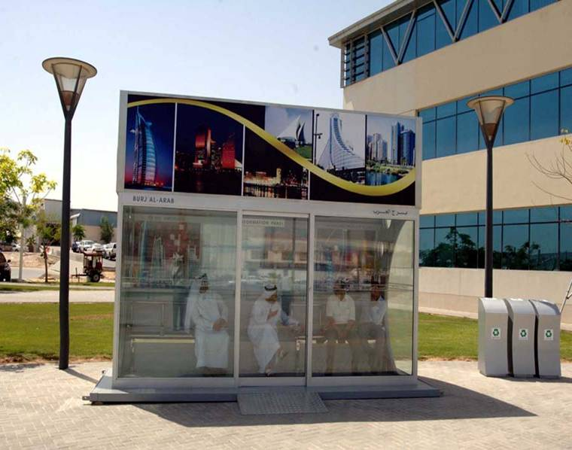
Wait

Slide 192
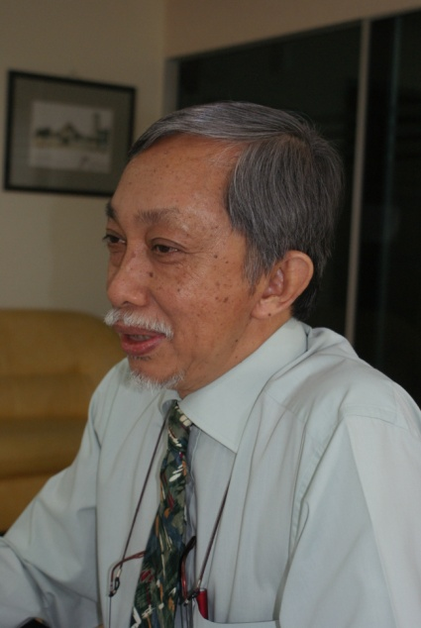


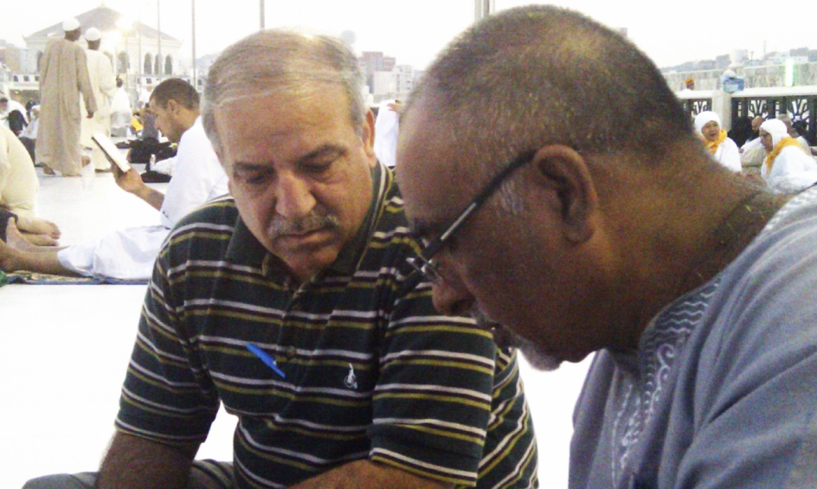
How to face an evaluator?
Silent
Less talking
Show document when asked
Talk nonsense
Distract
Ignore
Assume you know better
Don’t care

Slide 193
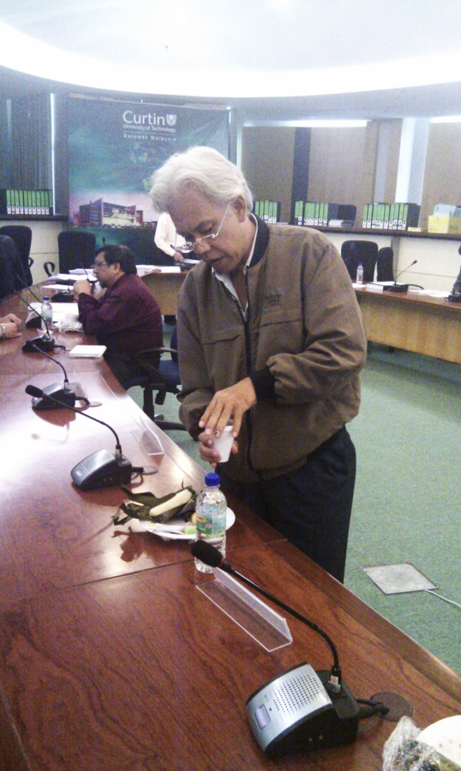
How do you close the loop ?
Follow up
Assessment Plan
Stakeholders participation
Action oriented

Slide 194

Make it simple
PEO
12 Outcomes
Course outcomes
KSA
Involvement
Assessment
Intervention (do not put all your eggs in one basket)
Starts complex then simplify

Slide 195
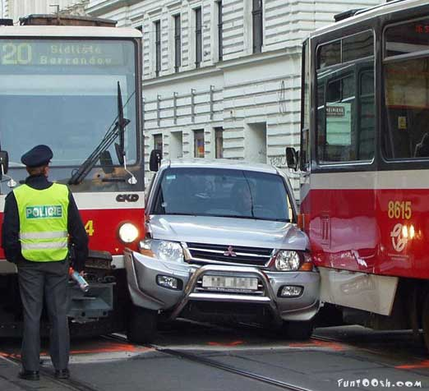
Programmes caught in between!
EAC
Management

Slide 196
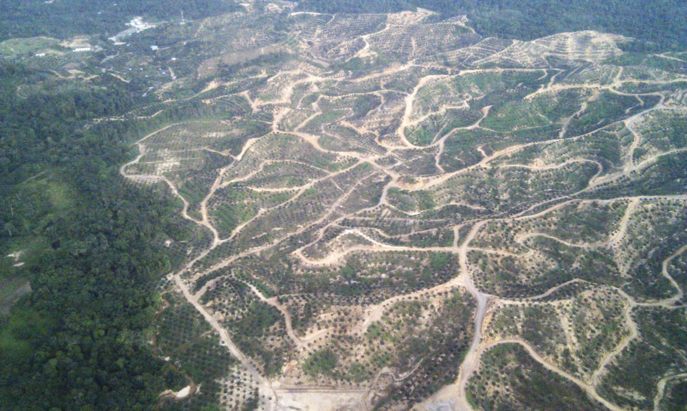
Big Picture

Slide 197

Conclusion
Quality education
OBE is student focus
Develop measurable & linked
  programme/course learning outcomes
  Learning (topic) objectives/outcomes
  assessment & evaluation
Plan for OBE; not by chance – “If you fail to plan means you plan to fail”
Implement teaching according to plan

Slide 198

Recommendations
Ensure consistency within a myriad of approaches
Training and implementation help build understanding and eventually a culture (Knowledge, Behaviour, Attitude)
Specifications
  Objective, implementation, results, evaluation, where applied, what improvement, and evidence
Show quality improvement
Evidence, evidence, evidence……. Relevant!

Slide 199
OBE Meets IHL (Now ... 2013)
May God bless the Smart Alex that brought the idea!
OBE makes us accountable
What is the best way of doing OBE?
Let us assess and evaluate the learning of students the right way

Slide 200

Evaluator’s contribution
Internal - recommend improvement
Always prepared
Helps management (School Prefect!)
Reviled & Hated

Slide 201

Job as a Lecturer
What do you think of your job as a lecturer?
TOO MUCH WORK

Slide 202


Slide 203
Thank you
Diversity within Consistency

